Slide 1

Report Card Marks 1 - 6
Critical Thinking

Slide 2
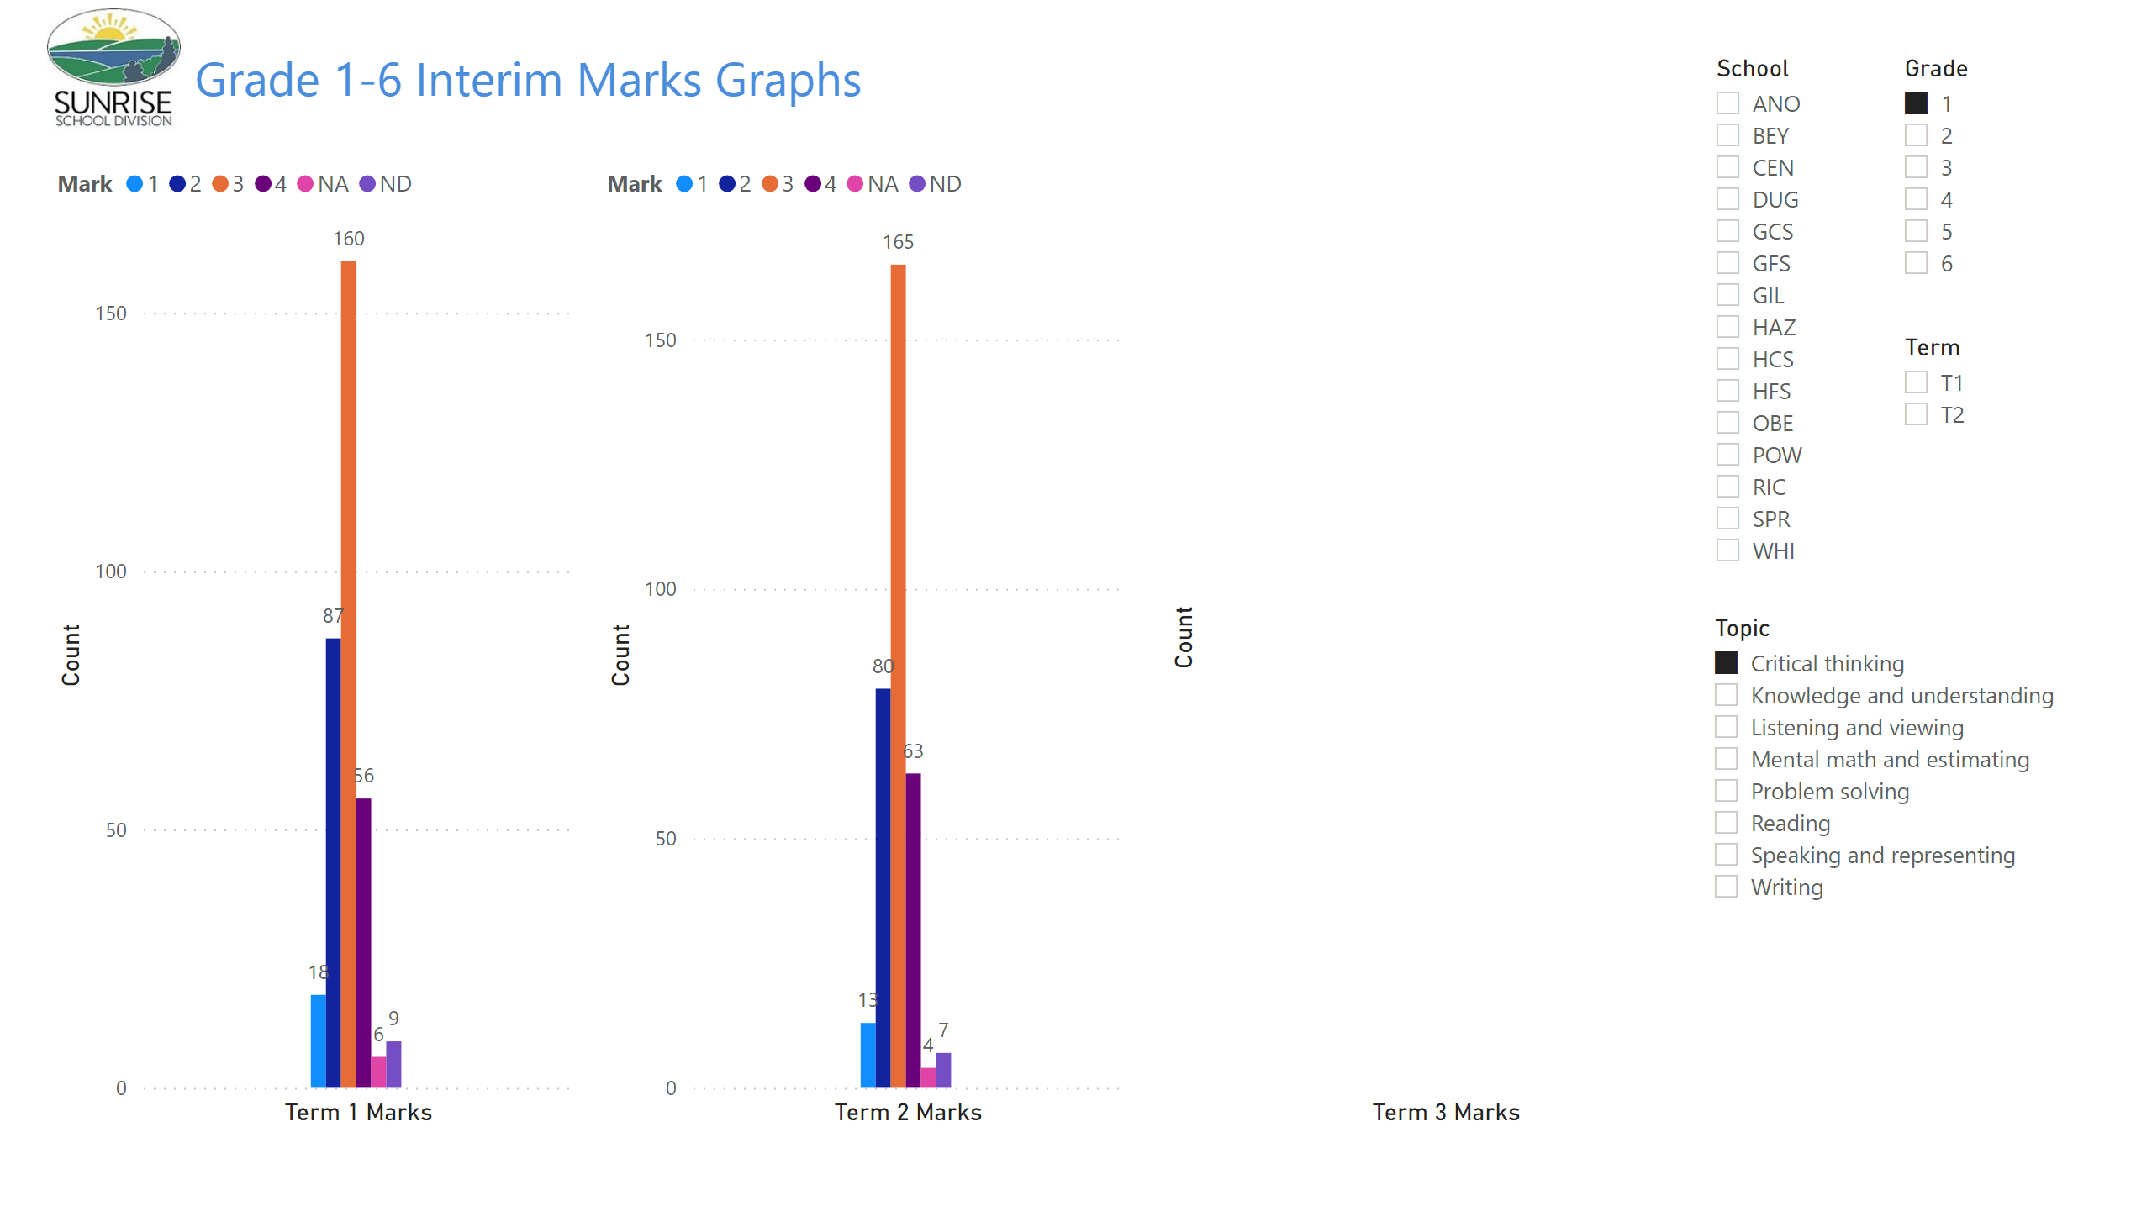
Gr 1-6 Term Graphs
Notes:
image
No alt text provided
textbox
No alt text provided
clusteredColumnChart
No alt text provided
slicer
No alt text provided
slicer
No alt text provided
slicer
No alt text provided
clusteredColumnChart
No alt text provided
clusteredColumnChart
No alt text provided
slicer
No alt text provided

Slide 3
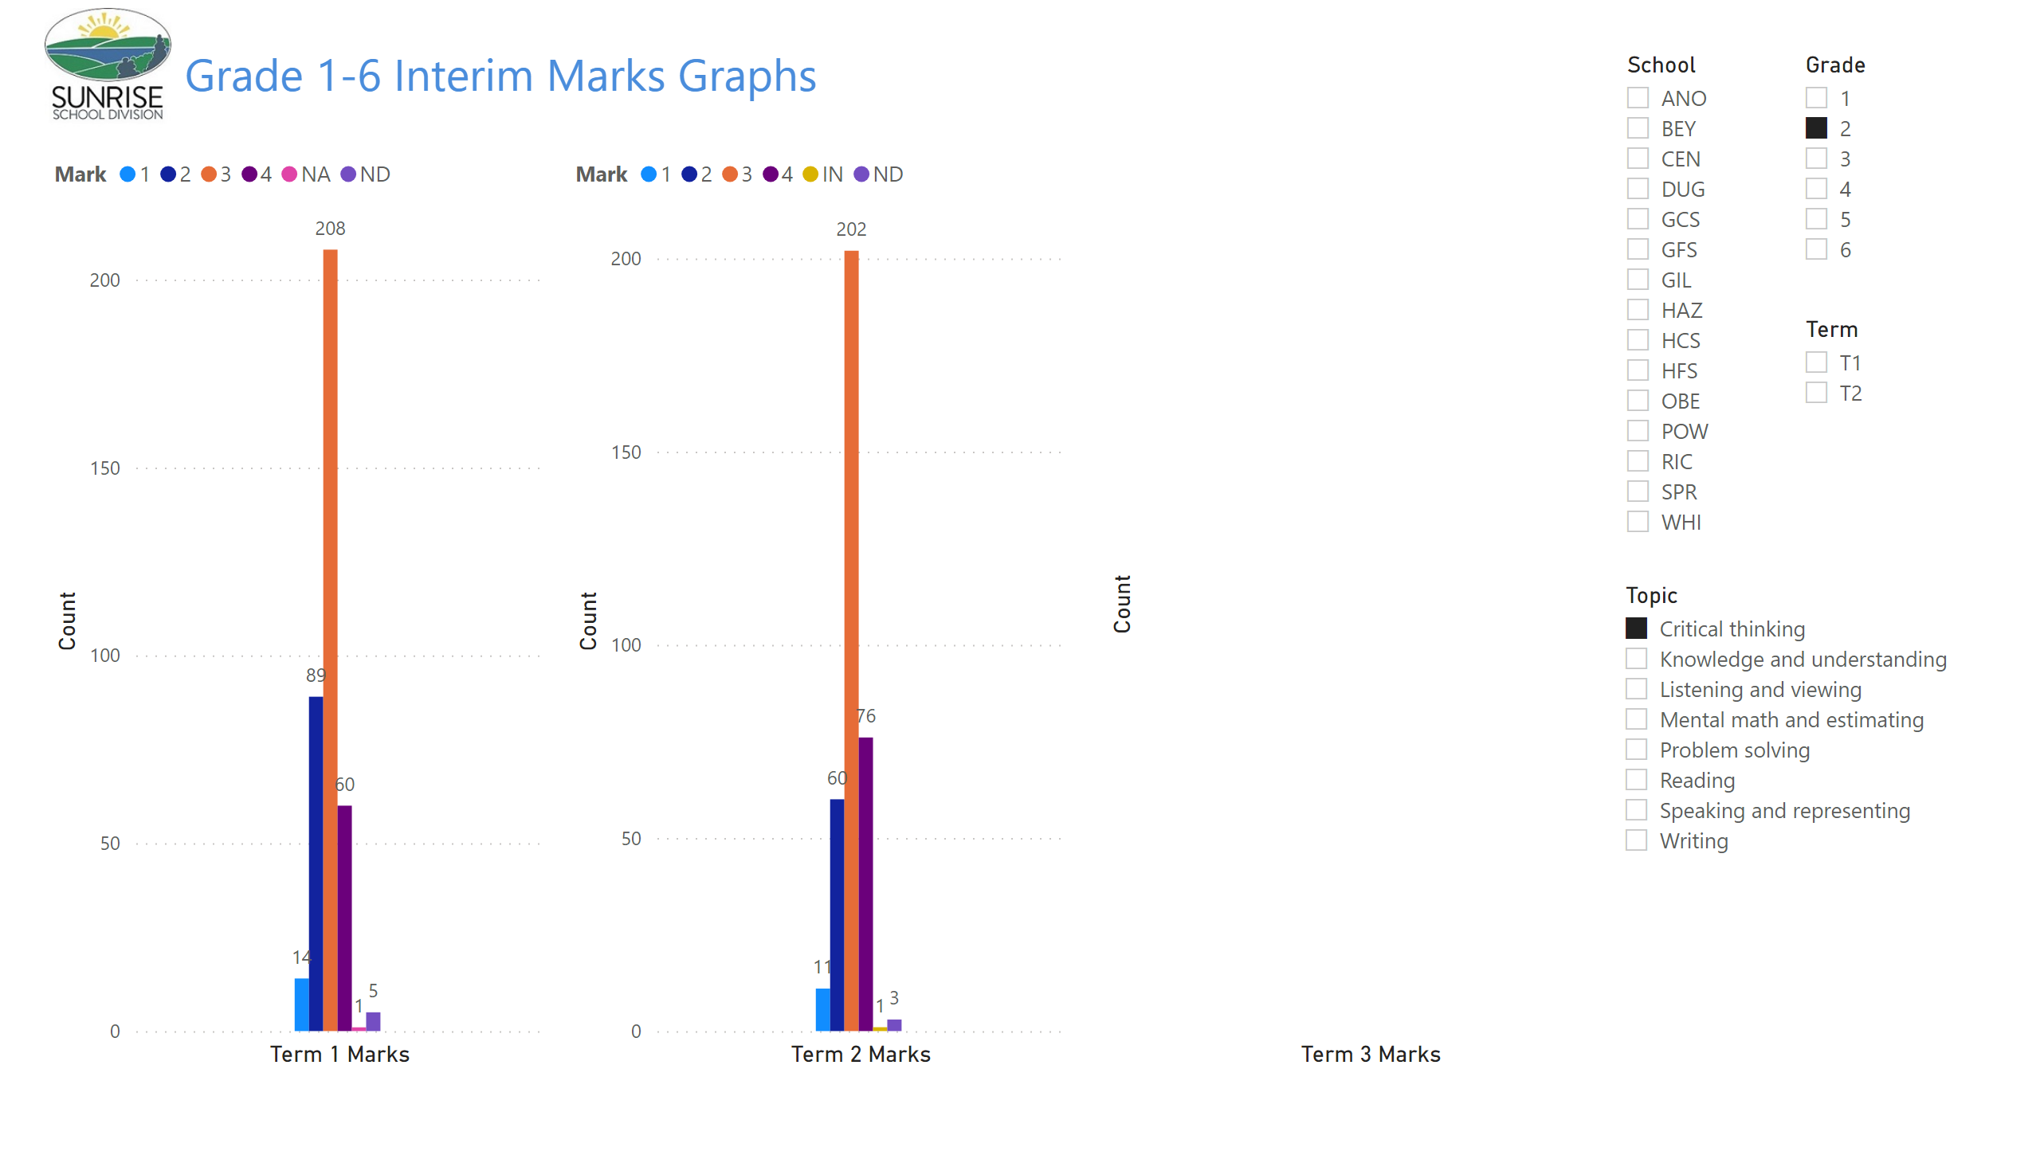
Gr 1-6 Term Graphs
Notes:
image
No alt text provided
textbox
No alt text provided
clusteredColumnChart
No alt text provided
slicer
No alt text provided
slicer
No alt text provided
slicer
No alt text provided
clusteredColumnChart
No alt text provided
clusteredColumnChart
No alt text provided
slicer
No alt text provided

Slide 4
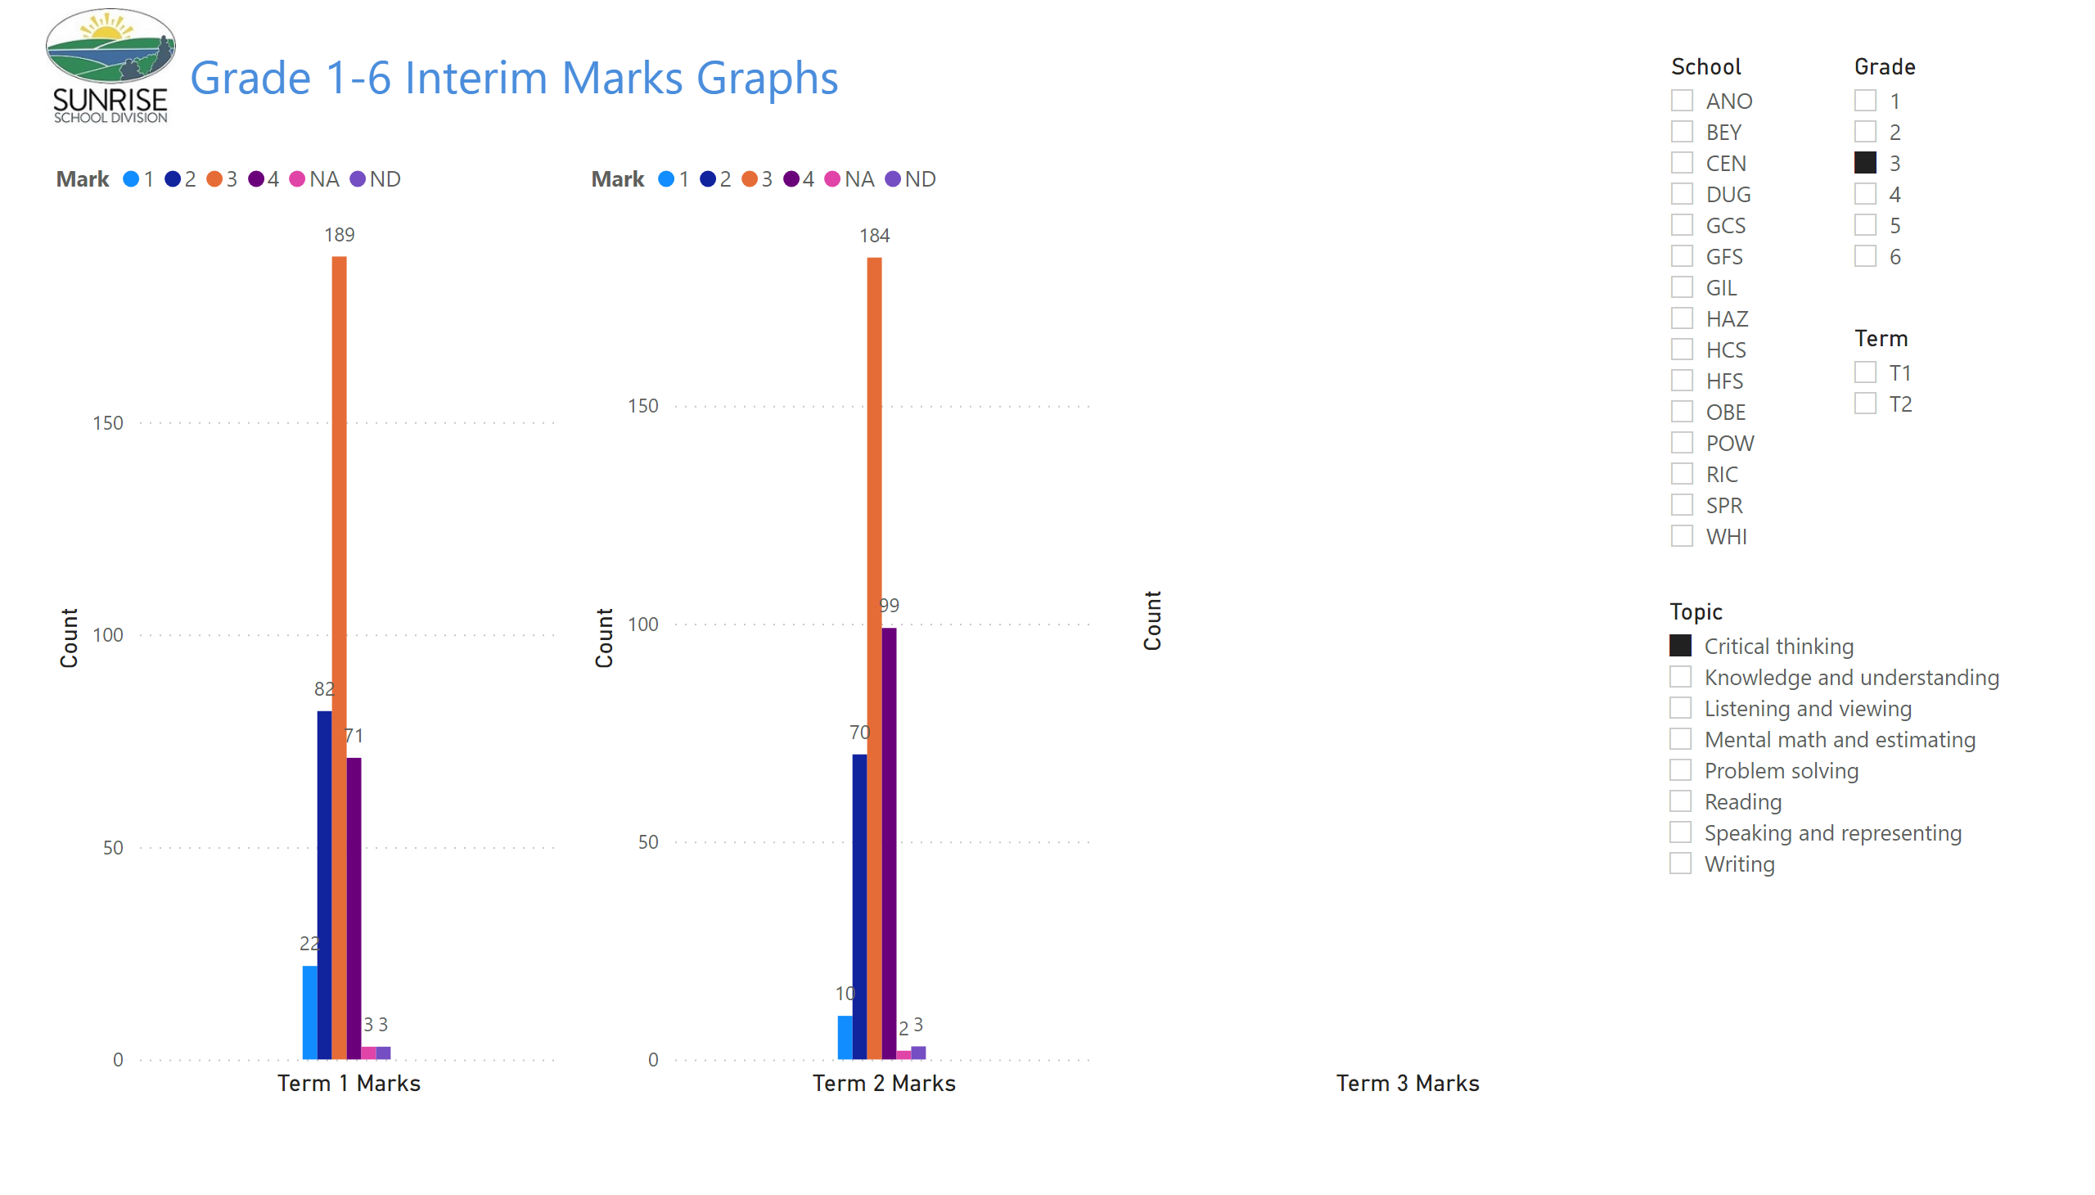
Gr 1-6 Term Graphs
Notes:
image
No alt text provided
textbox
No alt text provided
clusteredColumnChart
No alt text provided
slicer
No alt text provided
slicer
No alt text provided
slicer
No alt text provided
clusteredColumnChart
No alt text provided
clusteredColumnChart
No alt text provided
slicer
No alt text provided

Slide 5
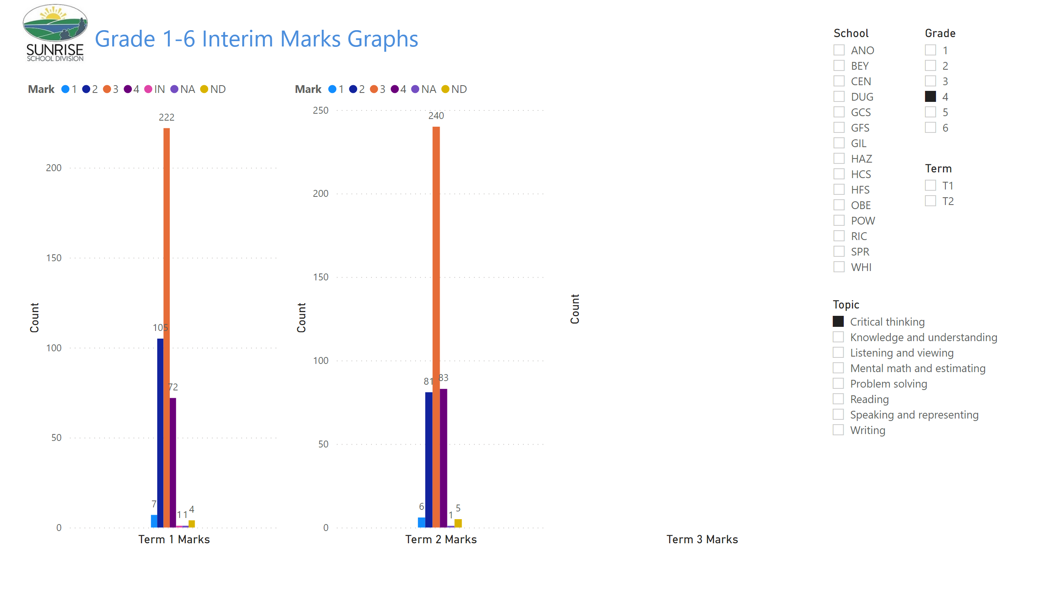
Gr 1-6 Term Graphs
Notes:
image
No alt text provided
textbox
No alt text provided
clusteredColumnChart
No alt text provided
slicer
No alt text provided
slicer
No alt text provided
slicer
No alt text provided
clusteredColumnChart
No alt text provided
clusteredColumnChart
No alt text provided
slicer
No alt text provided

Slide 6

Gr 1-6 Term Graphs
Notes:
image
No alt text provided
textbox
No alt text provided
clusteredColumnChart
No alt text provided
slicer
No alt text provided
slicer
No alt text provided
slicer
No alt text provided
clusteredColumnChart
No alt text provided
clusteredColumnChart
No alt text provided
slicer
No alt text provided

Slide 7
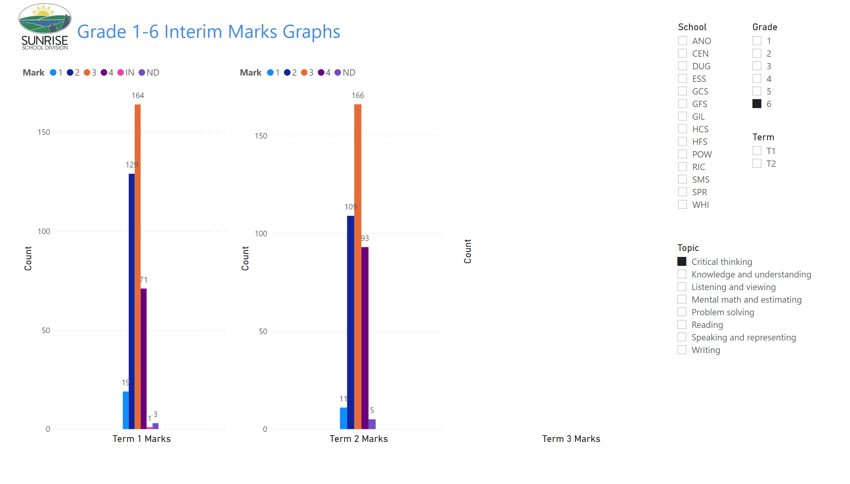
Gr 1-6 Term Graphs
Notes:
image
No alt text provided
textbox
No alt text provided
clusteredColumnChart
No alt text provided
slicer
No alt text provided
slicer
No alt text provided
slicer
No alt text provided
clusteredColumnChart
No alt text provided
clusteredColumnChart
No alt text provided
slicer
No alt text provided

Slide 8
Report Card Marks 1 - 6
Problem Solving

Slide 9
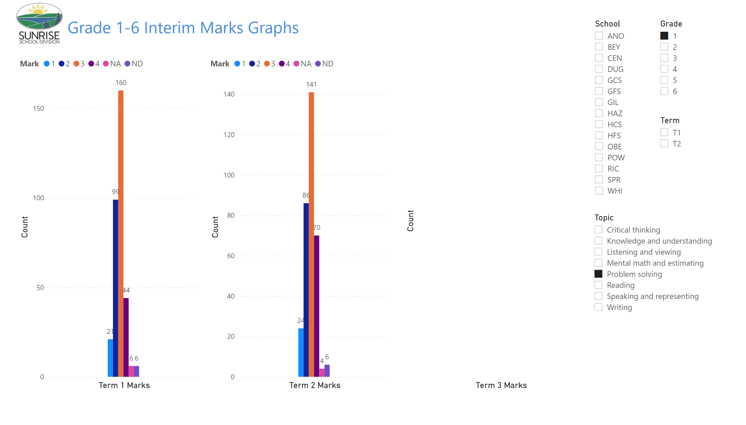
Gr 1-6 Term Graphs
Notes:
image
No alt text provided
textbox
No alt text provided
clusteredColumnChart
No alt text provided
slicer
No alt text provided
slicer
No alt text provided
slicer
No alt text provided
clusteredColumnChart
No alt text provided
clusteredColumnChart
No alt text provided
slicer
No alt text provided

Slide 10
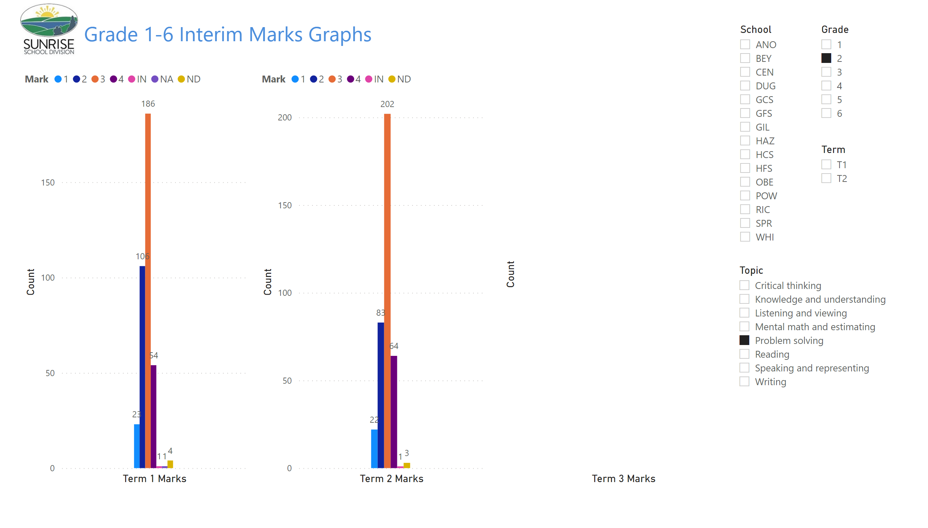
Gr 1-6 Term Graphs
Notes:
image
No alt text provided
textbox
No alt text provided
clusteredColumnChart
No alt text provided
slicer
No alt text provided
slicer
No alt text provided
slicer
No alt text provided
clusteredColumnChart
No alt text provided
clusteredColumnChart
No alt text provided
slicer
No alt text provided

Slide 11
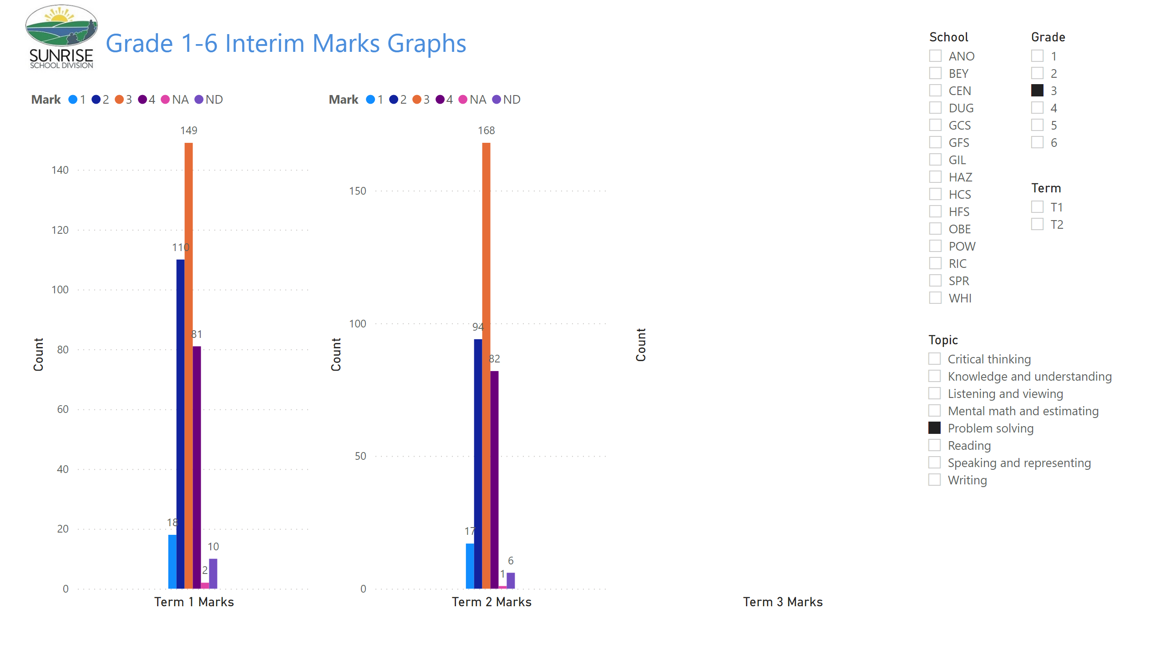
Gr 1-6 Term Graphs
Notes:
image
No alt text provided
textbox
No alt text provided
clusteredColumnChart
No alt text provided
slicer
No alt text provided
slicer
No alt text provided
slicer
No alt text provided
clusteredColumnChart
No alt text provided
clusteredColumnChart
No alt text provided
slicer
No alt text provided

Slide 12
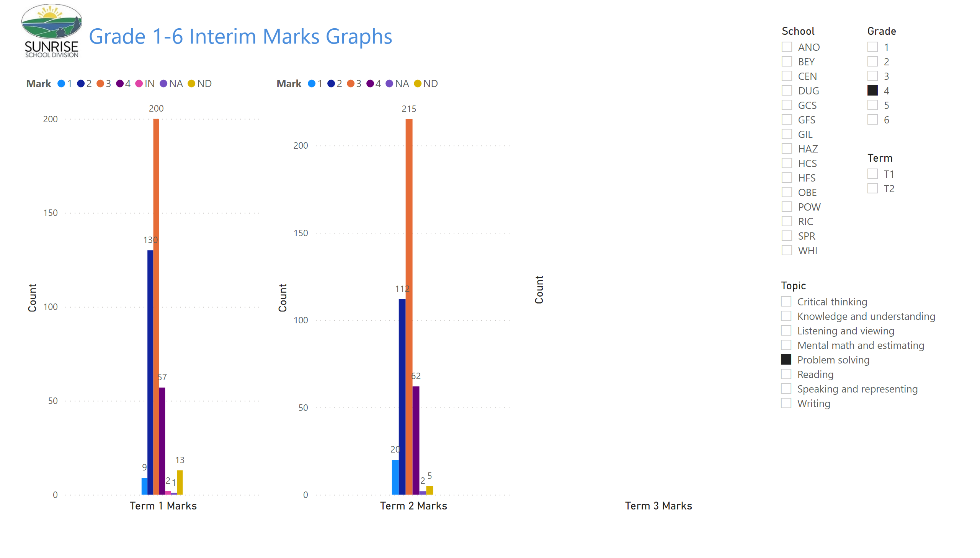
Gr 1-6 Term Graphs
Notes:
image
No alt text provided
textbox
No alt text provided
clusteredColumnChart
No alt text provided
slicer
No alt text provided
slicer
No alt text provided
slicer
No alt text provided
clusteredColumnChart
No alt text provided
clusteredColumnChart
No alt text provided
slicer
No alt text provided

Slide 13
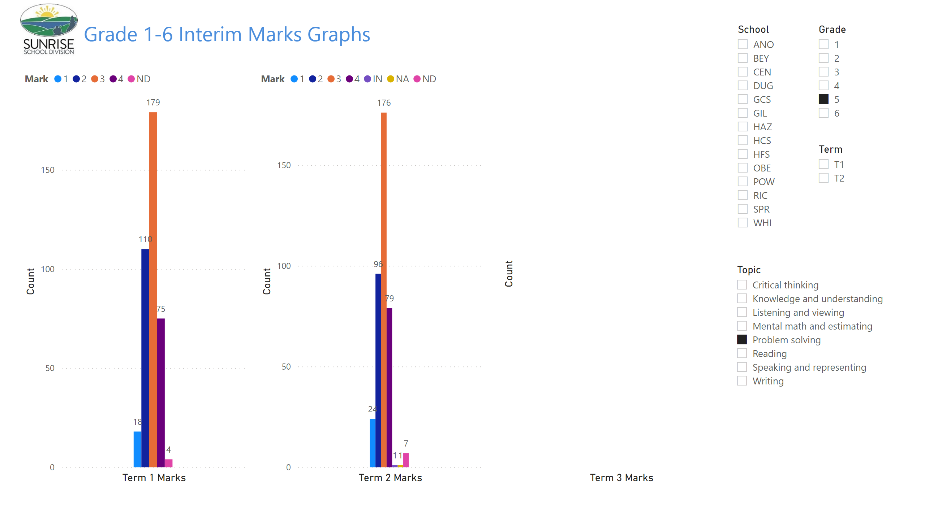
Gr 1-6 Term Graphs
Notes:
image
No alt text provided
textbox
No alt text provided
clusteredColumnChart
No alt text provided
slicer
No alt text provided
slicer
No alt text provided
slicer
No alt text provided
clusteredColumnChart
No alt text provided
clusteredColumnChart
No alt text provided
slicer
No alt text provided

Slide 14
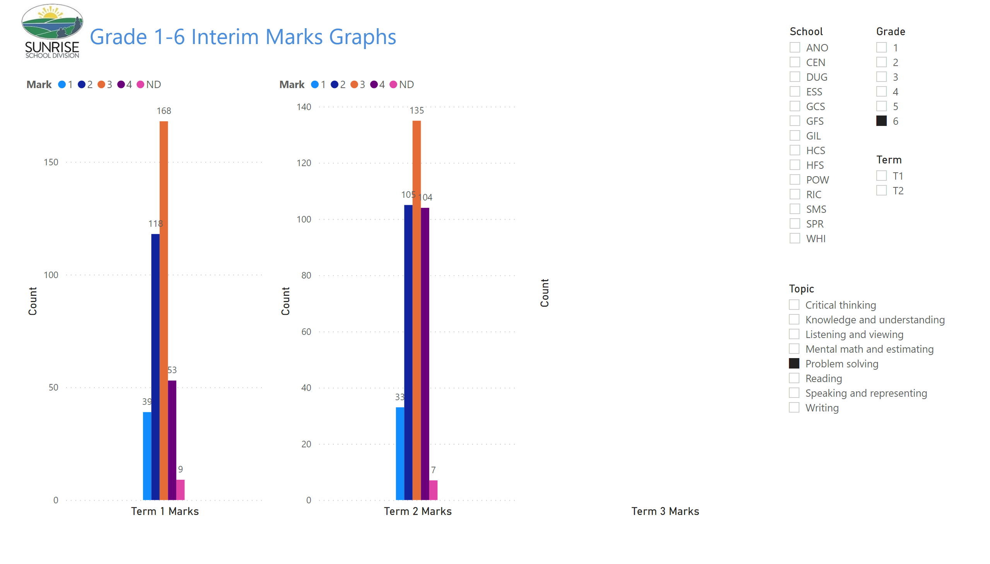
Gr 1-6 Term Graphs
Notes:
image
No alt text provided
textbox
No alt text provided
clusteredColumnChart
No alt text provided
slicer
No alt text provided
slicer
No alt text provided
slicer
No alt text provided
clusteredColumnChart
No alt text provided
clusteredColumnChart
No alt text provided
slicer
No alt text provided

Slide 15
Report Card Marks 1 - 6
Comprehension Reading

Slide 16
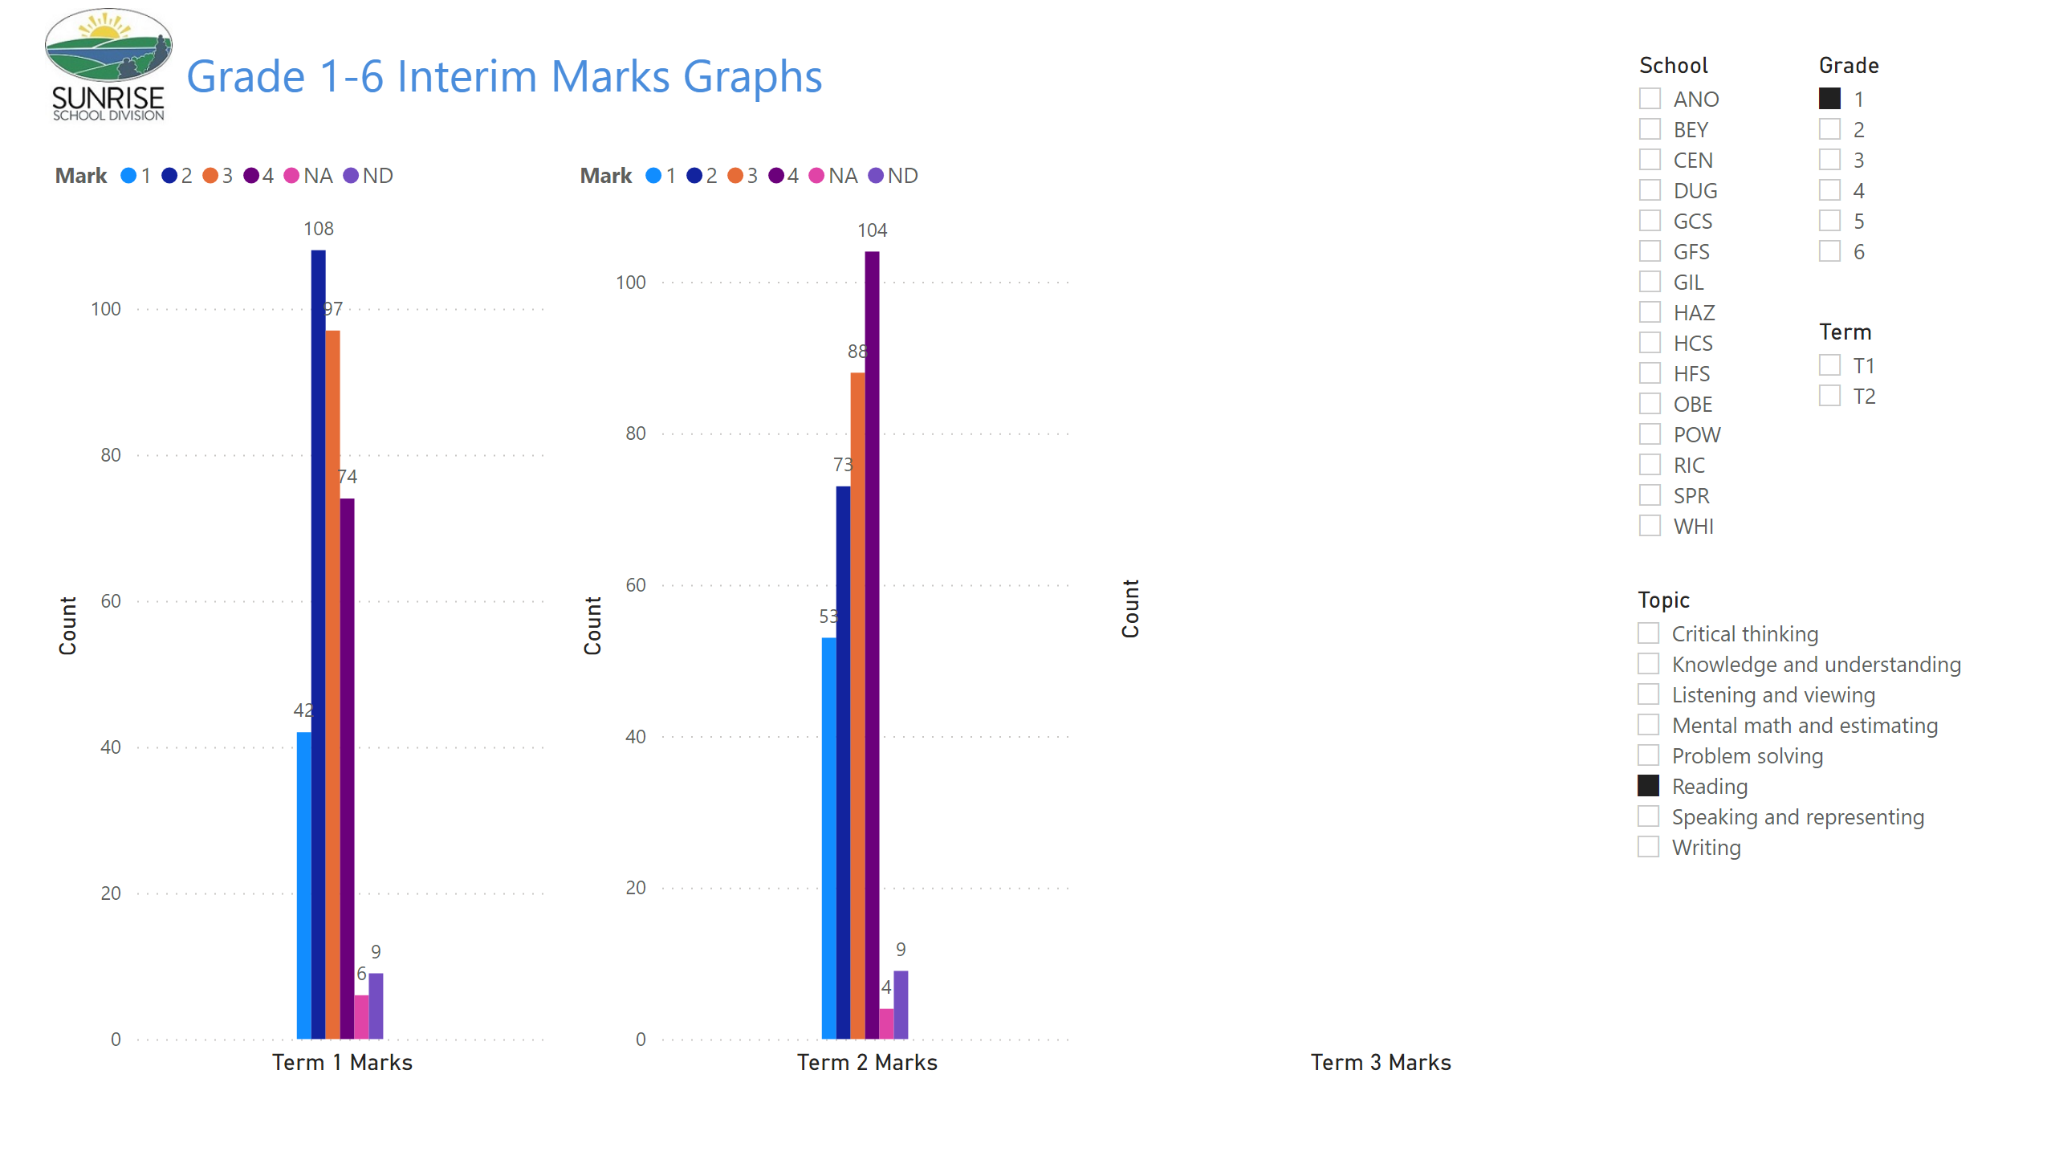
Gr 1-6 Term Graphs
Notes:
image
No alt text provided
textbox
No alt text provided
clusteredColumnChart
No alt text provided
slicer
No alt text provided
slicer
No alt text provided
slicer
No alt text provided
clusteredColumnChart
No alt text provided
clusteredColumnChart
No alt text provided
slicer
No alt text provided

Slide 17
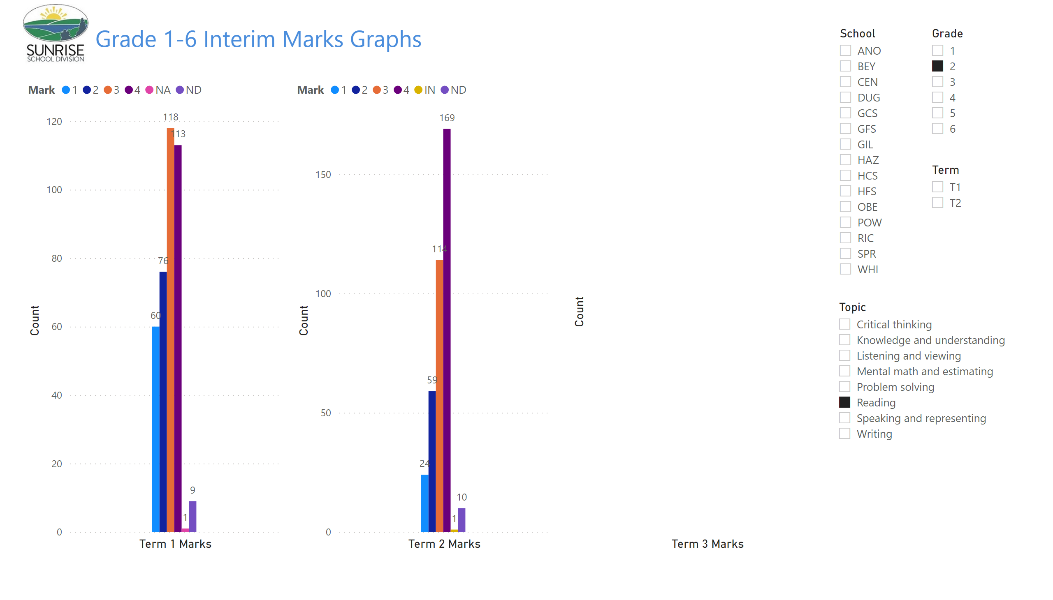
Gr 1-6 Term Graphs
Notes:
image
No alt text provided
textbox
No alt text provided
clusteredColumnChart
No alt text provided
slicer
No alt text provided
slicer
No alt text provided
slicer
No alt text provided
clusteredColumnChart
No alt text provided
clusteredColumnChart
No alt text provided
slicer
No alt text provided

Slide 18
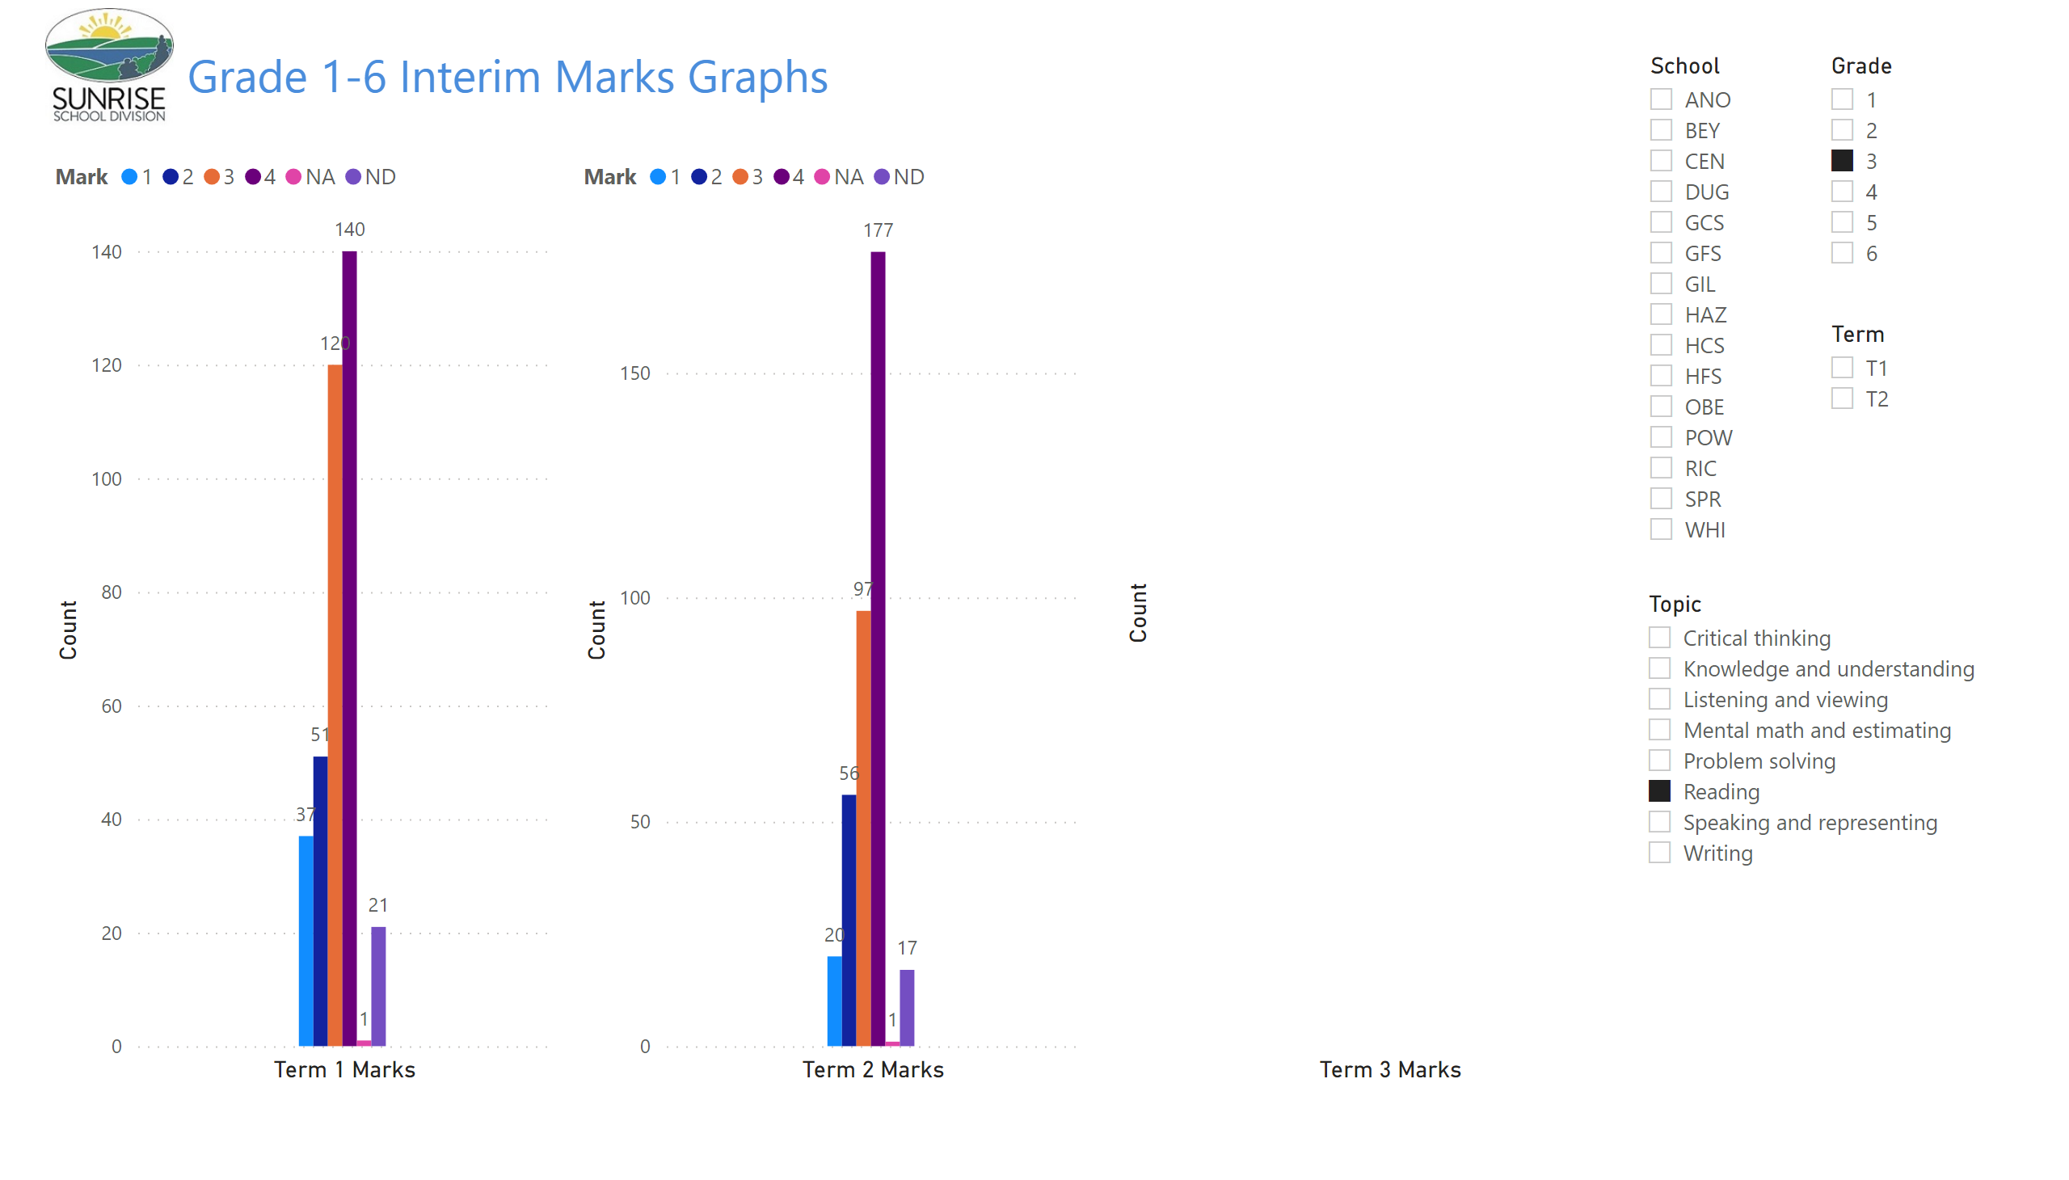
Gr 1-6 Term Graphs
Notes:
image
No alt text provided
textbox
No alt text provided
clusteredColumnChart
No alt text provided
slicer
No alt text provided
slicer
No alt text provided
slicer
No alt text provided
clusteredColumnChart
No alt text provided
clusteredColumnChart
No alt text provided
slicer
No alt text provided

Slide 19
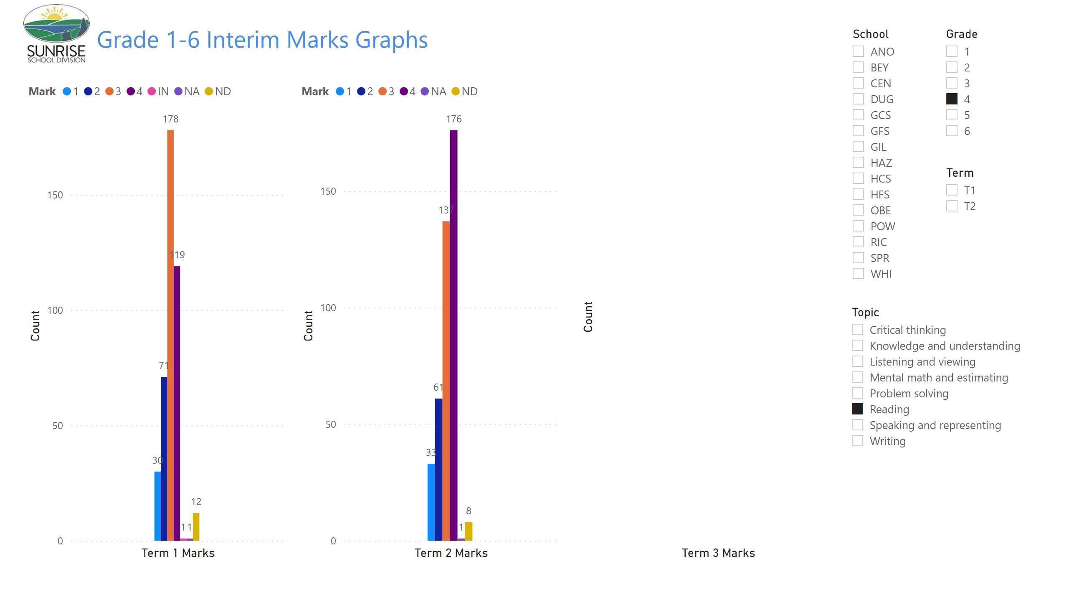
Gr 1-6 Term Graphs
Notes:
image
No alt text provided
textbox
No alt text provided
clusteredColumnChart
No alt text provided
slicer
No alt text provided
slicer
No alt text provided
slicer
No alt text provided
clusteredColumnChart
No alt text provided
clusteredColumnChart
No alt text provided
slicer
No alt text provided

Slide 20
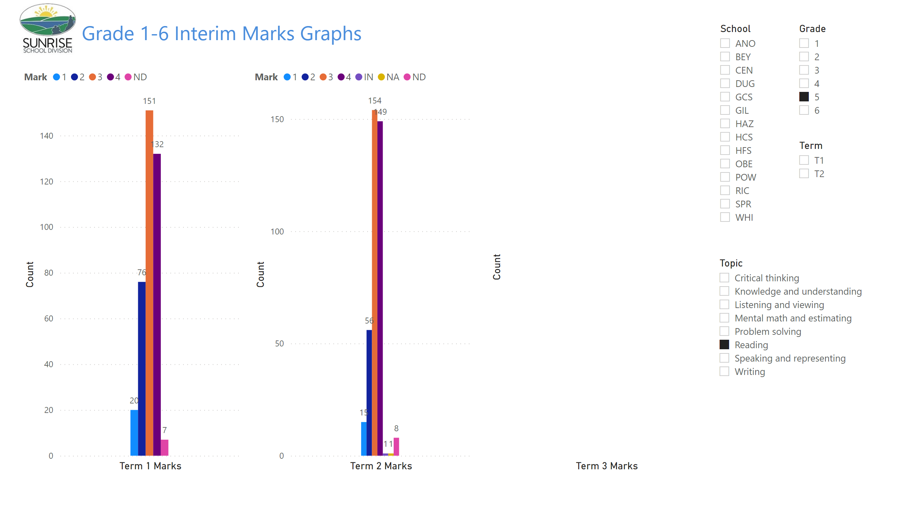
Gr 1-6 Term Graphs
Notes:
image
No alt text provided
textbox
No alt text provided
clusteredColumnChart
No alt text provided
slicer
No alt text provided
slicer
No alt text provided
slicer
No alt text provided
clusteredColumnChart
No alt text provided
clusteredColumnChart
No alt text provided
slicer
No alt text provided

Slide 21
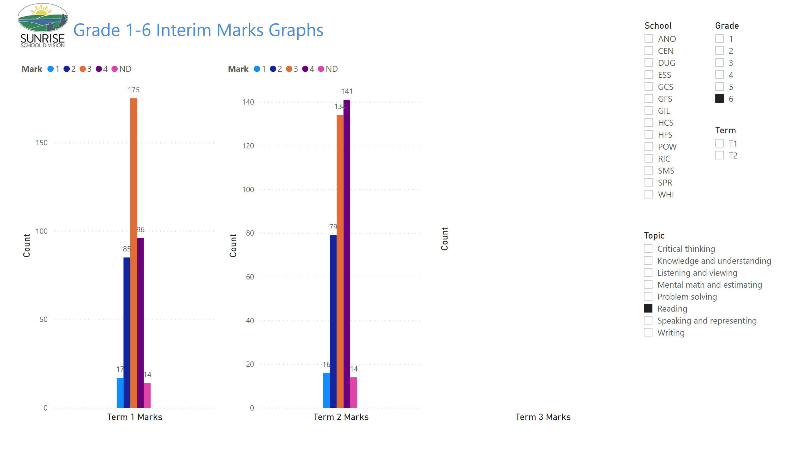
Gr 1-6 Term Graphs
Notes:
image
No alt text provided
textbox
No alt text provided
clusteredColumnChart
No alt text provided
slicer
No alt text provided
slicer
No alt text provided
slicer
No alt text provided
clusteredColumnChart
No alt text provided
clusteredColumnChart
No alt text provided
slicer
No alt text provided

Slide 22
Report Card Marks 7 - 8
Critical Thinking

Slide 23
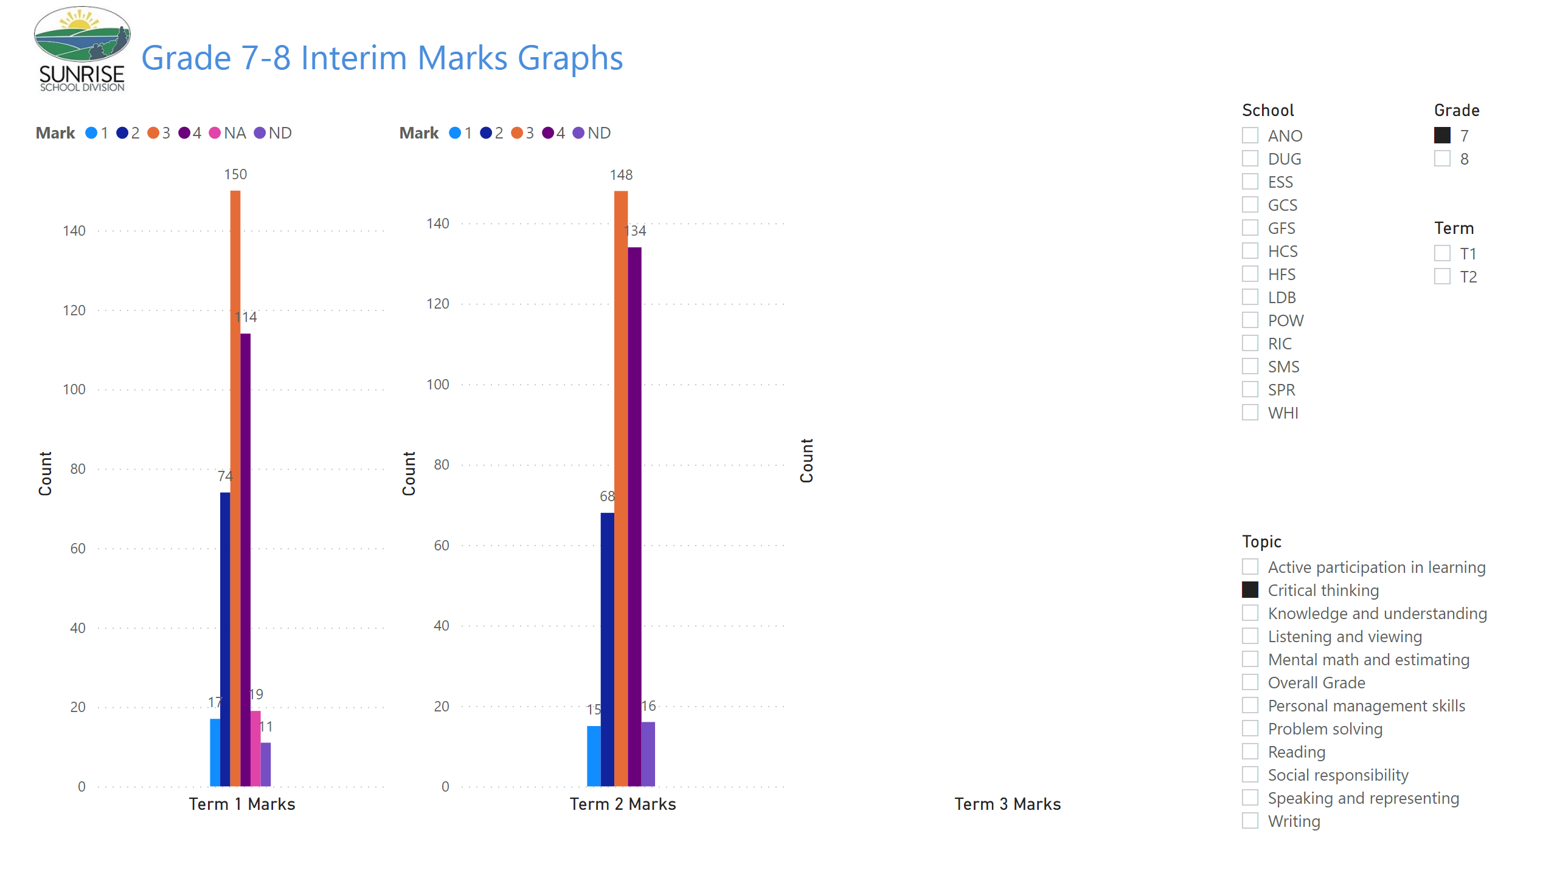
Gr 7-8 Term Graphs
Notes:
image
No alt text provided
textbox
No alt text provided
clusteredColumnChart
No alt text provided
slicer
No alt text provided
slicer
No alt text provided
slicer
No alt text provided
clusteredColumnChart
No alt text provided
clusteredColumnChart
No alt text provided
slicer
No alt text provided

Slide 24
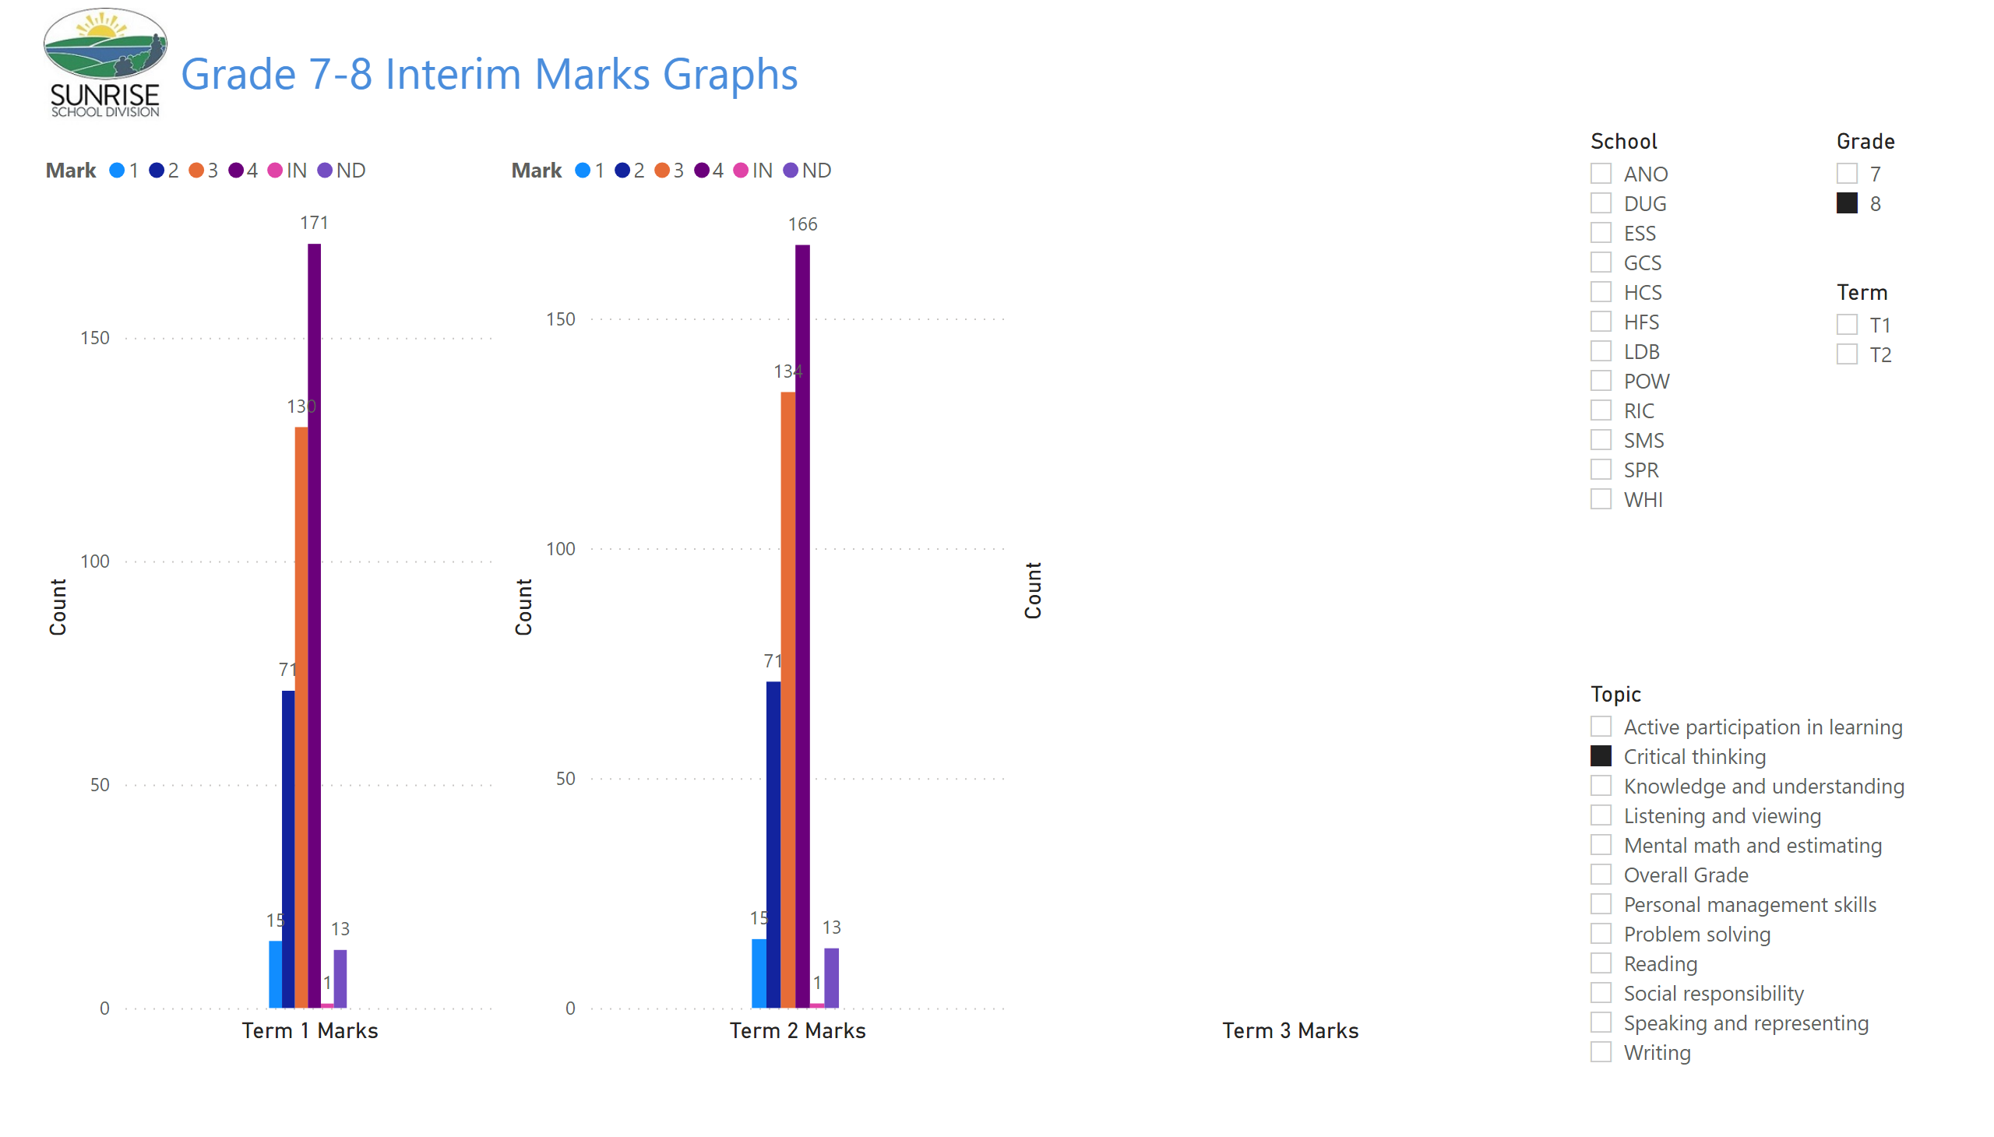
Gr 7-8 Term Graphs
Notes:
image
No alt text provided
textbox
No alt text provided
clusteredColumnChart
No alt text provided
slicer
No alt text provided
slicer
No alt text provided
slicer
No alt text provided
clusteredColumnChart
No alt text provided
clusteredColumnChart
No alt text provided
slicer
No alt text provided

Slide 25
Report Card Marks 7 - 8
Problem Solving

Slide 26
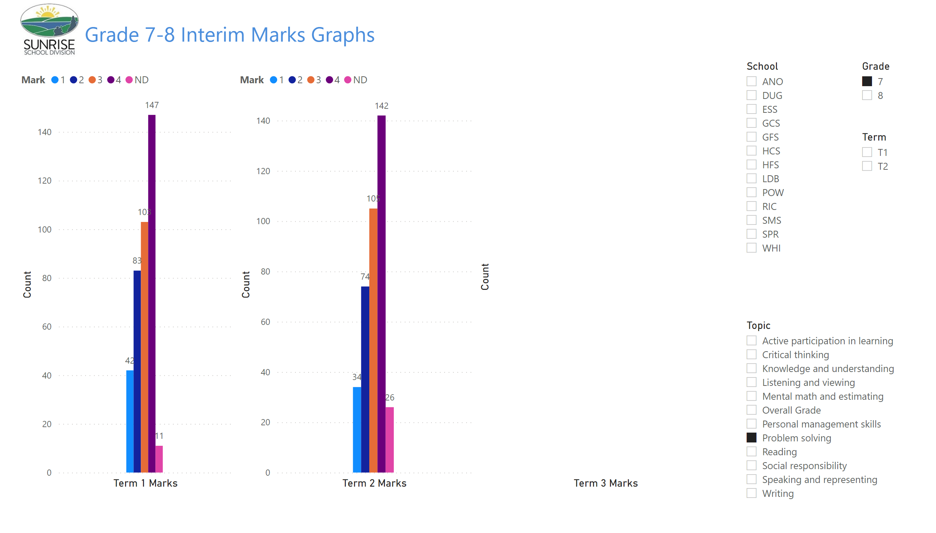
Gr 7-8 Term Graphs
Notes:
image
No alt text provided
textbox
No alt text provided
clusteredColumnChart
No alt text provided
slicer
No alt text provided
slicer
No alt text provided
slicer
No alt text provided
clusteredColumnChart
No alt text provided
clusteredColumnChart
No alt text provided
slicer
No alt text provided

Slide 27
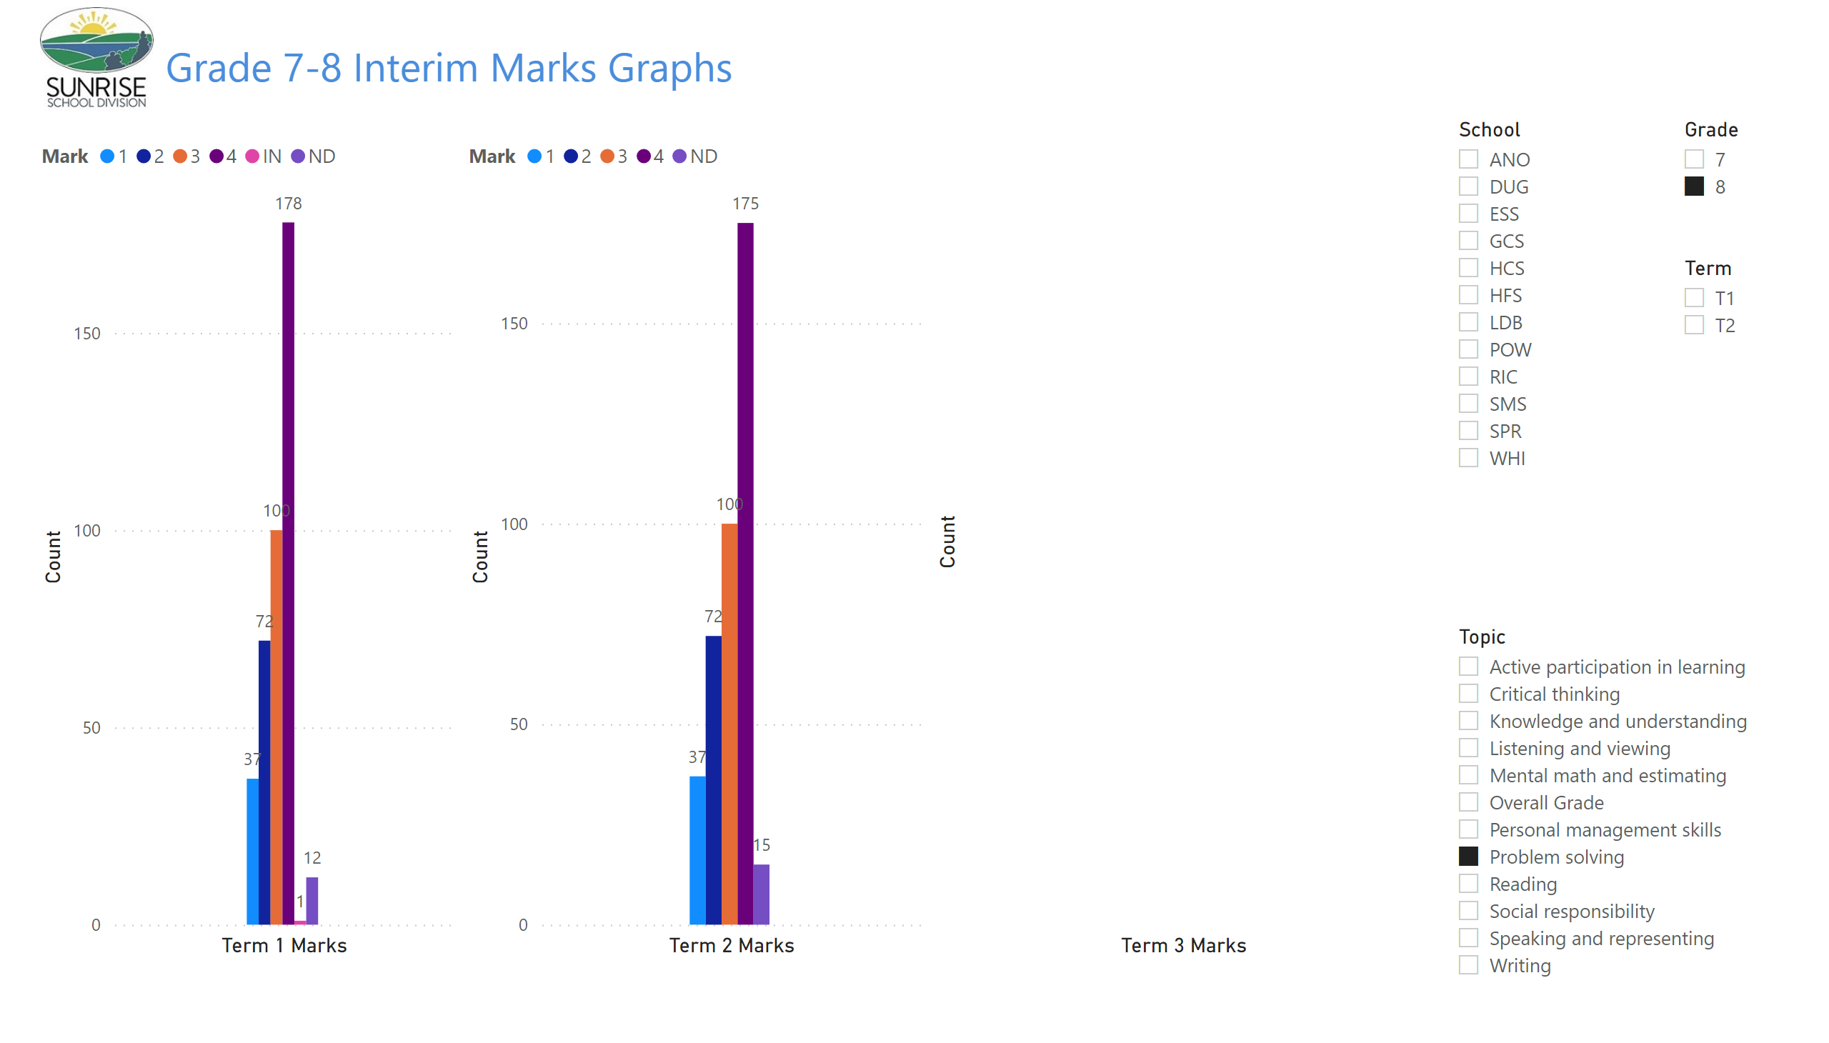
Gr 7-8 Term Graphs
Notes:
image
No alt text provided
textbox
No alt text provided
clusteredColumnChart
No alt text provided
slicer
No alt text provided
slicer
No alt text provided
slicer
No alt text provided
clusteredColumnChart
No alt text provided
clusteredColumnChart
No alt text provided
slicer
No alt text provided

Slide 28
Report Card Marks 7 - 8
Comprehension Reading

Slide 29
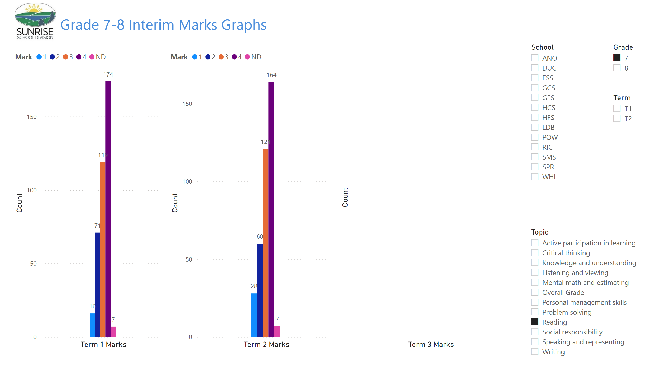
Gr 7-8 Term Graphs
Notes:
image
No alt text provided
textbox
No alt text provided
clusteredColumnChart
No alt text provided
slicer
No alt text provided
slicer
No alt text provided
slicer
No alt text provided
clusteredColumnChart
No alt text provided
clusteredColumnChart
No alt text provided
slicer
No alt text provided

Slide 30
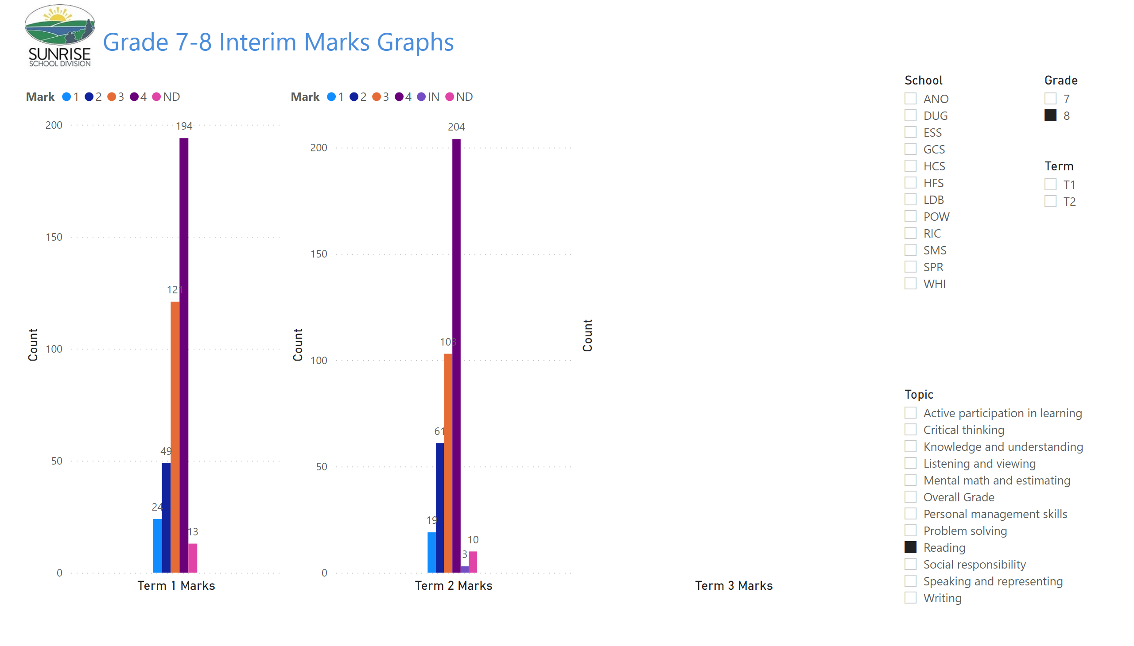
Gr 7-8 Term Graphs
Notes:
image
No alt text provided
textbox
No alt text provided
clusteredColumnChart
No alt text provided
slicer
No alt text provided
slicer
No alt text provided
slicer
No alt text provided
clusteredColumnChart
No alt text provided
clusteredColumnChart
No alt text provided
slicer
No alt text provided

Slide 31
Report Card Marks 7 - 8
Communication Writing

Slide 32
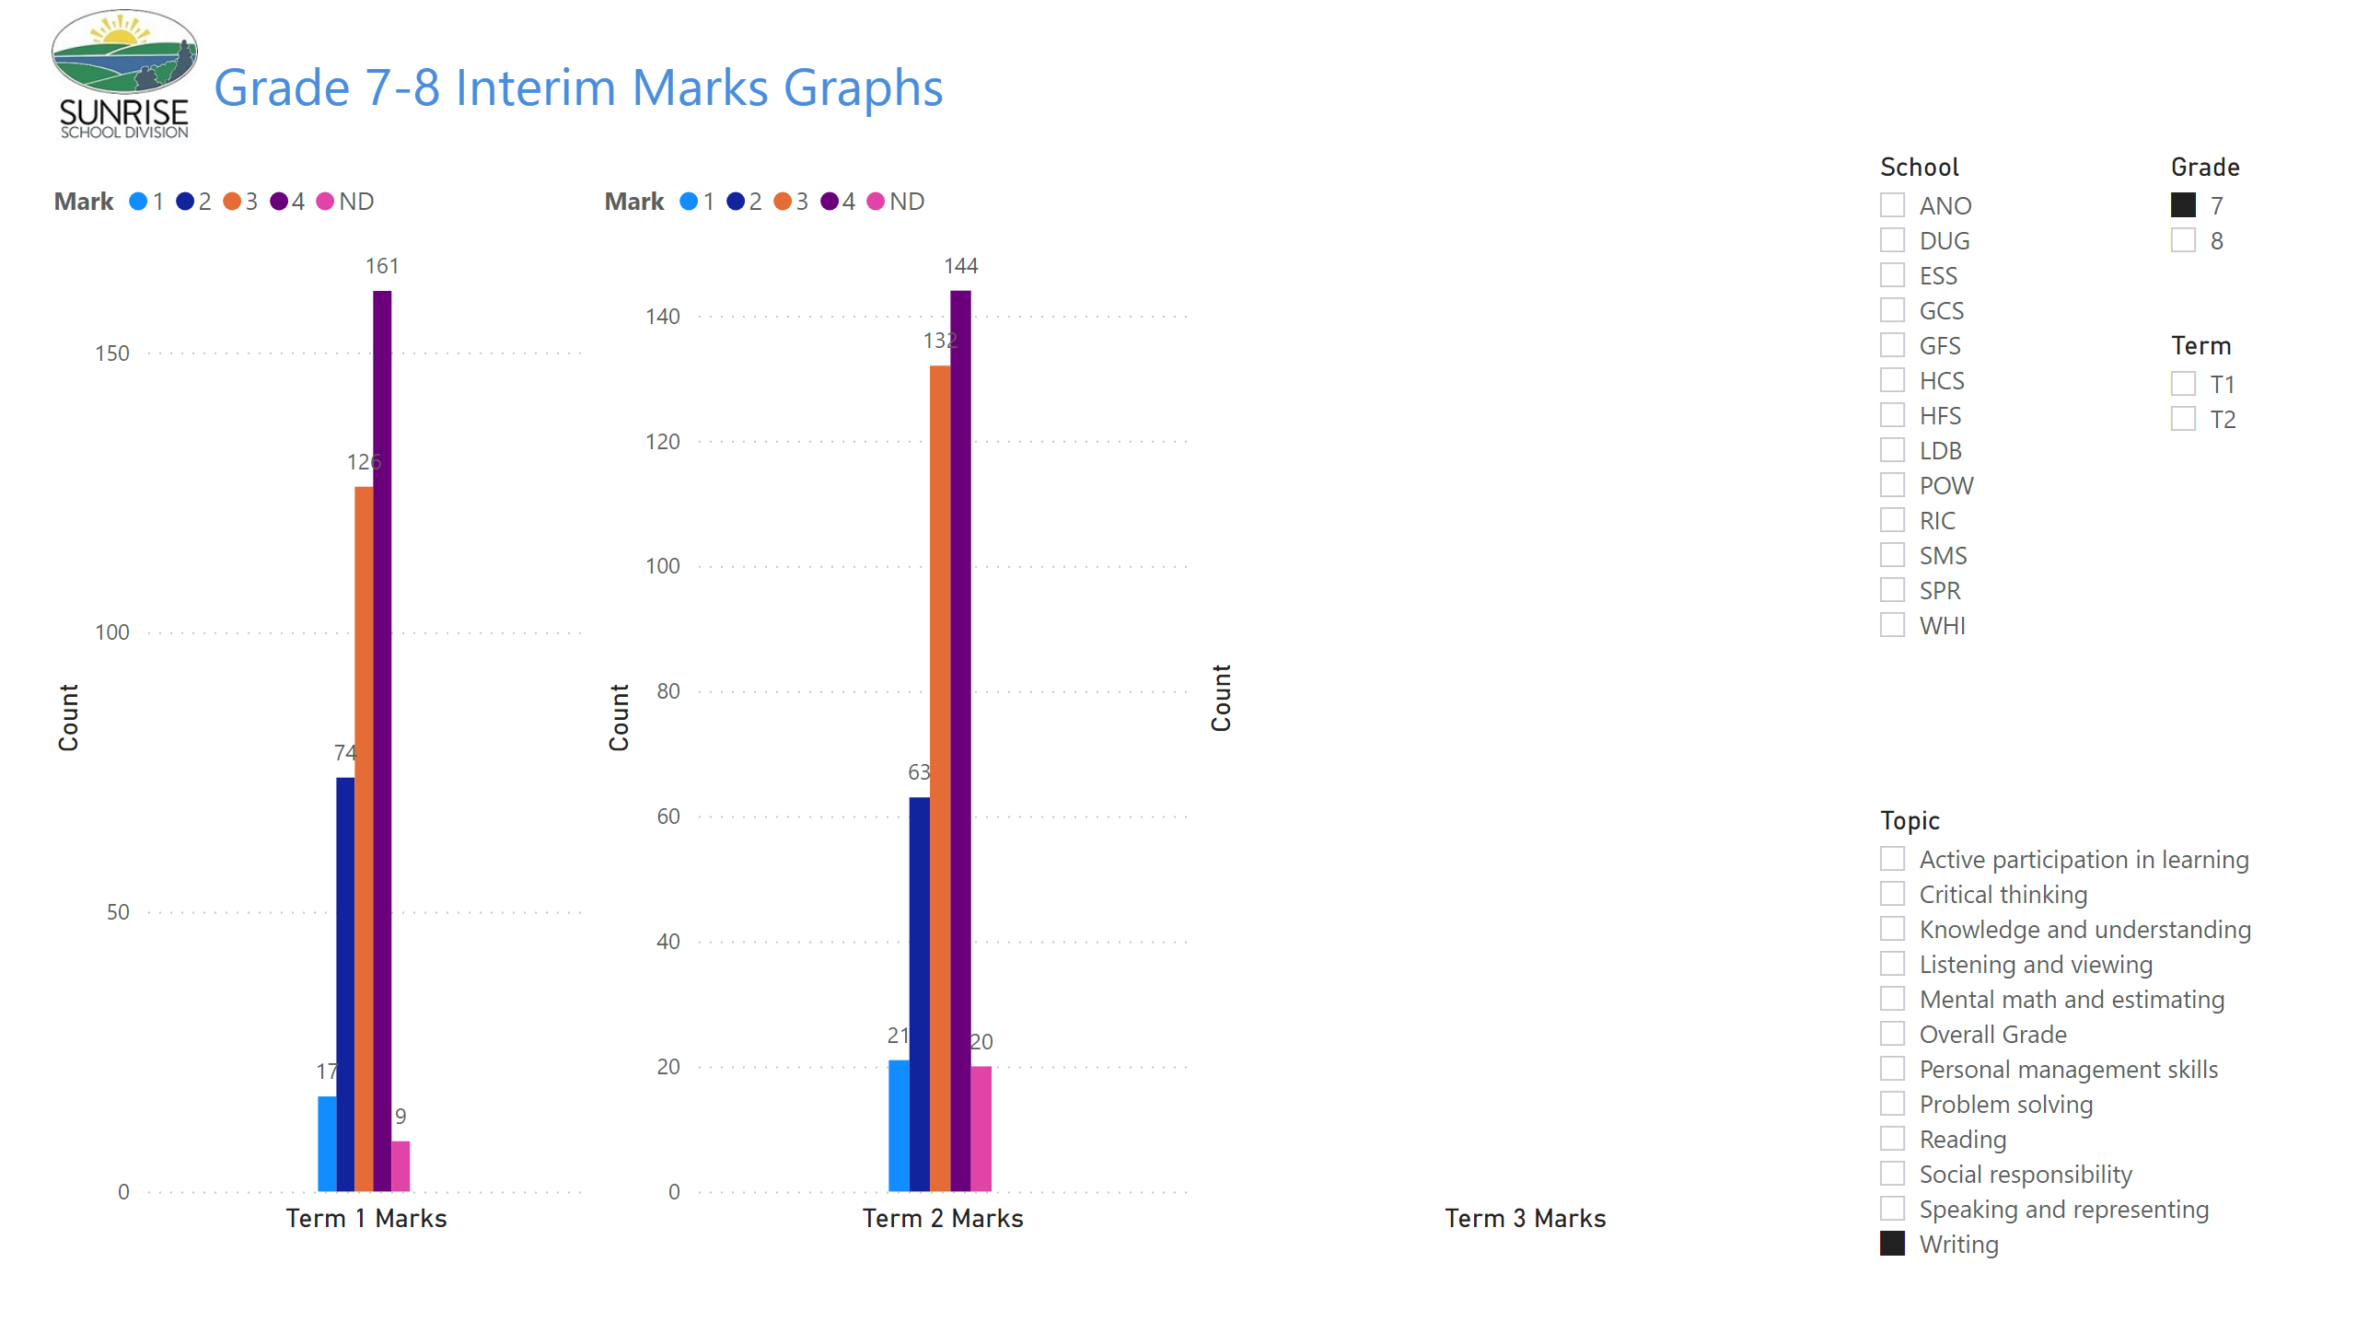
Gr 7-8 Term Graphs
Notes:
image
No alt text provided
textbox
No alt text provided
clusteredColumnChart
No alt text provided
slicer
No alt text provided
slicer
No alt text provided
slicer
No alt text provided
clusteredColumnChart
No alt text provided
clusteredColumnChart
No alt text provided
slicer
No alt text provided

Slide 33
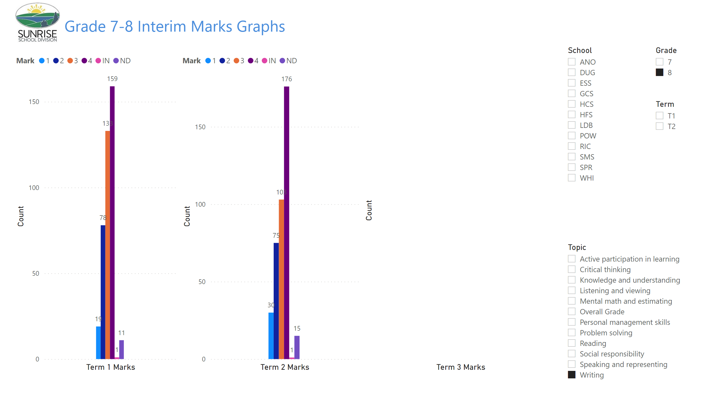
Gr 7-8 Term Graphs
Notes:
image
No alt text provided
textbox
No alt text provided
clusteredColumnChart
No alt text provided
slicer
No alt text provided
slicer
No alt text provided
slicer
No alt text provided
clusteredColumnChart
No alt text provided
clusteredColumnChart
No alt text provided
slicer
No alt text provided

