Slide 1


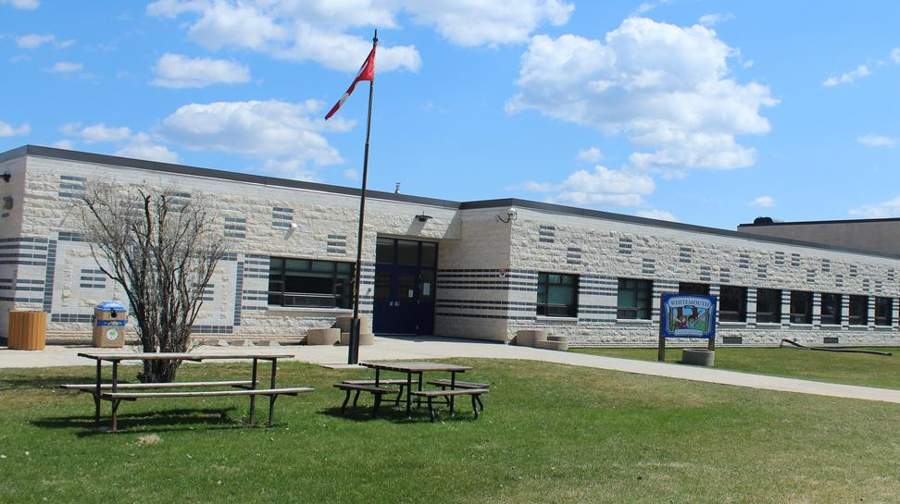


Whitemouth School
Home of the Warriors
Notes:
Good evening, I want to thank the Sunrise School Division school board for giving me the opportunity to talk about the great things that are occurring at Whitemouth School.

Slide 2
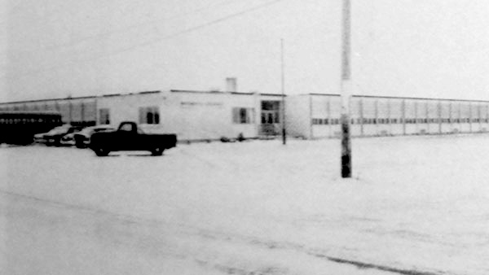
WMS - - Manitoba Historical Site
Built in 1961 and officially opened on September 15, 1961.
Whitemouth Collegiate
Architectural design – Zunic and Sobkowich
Construction – Louis Ducharme and Associates
Originally had 7 classrooms, a library, commercial room, science lab and auditorium.
Staff consisted of teachers, principal, janitor and a nurse!
In 1971, expansion occurred, and Whitemouth Elementary moved to the collegiate creating a K-12 school.
First Principal of Whitemouth Collegiate (Donald S. Smith)
Notes:
Picture in the background is from November 1967

Slide 3
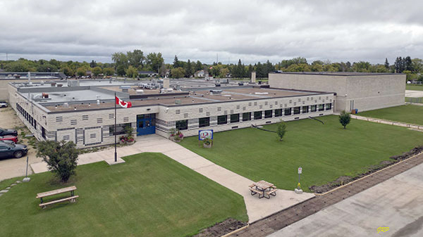
WMS Today!
K – 12 school with 171 students.
  Elementary – 82
  Middle Years – 28
  High School – 61
11.28 Instruction/ 4.0 Student Support / 2.94 Custodial / 1.0 Librarian

Slide 4
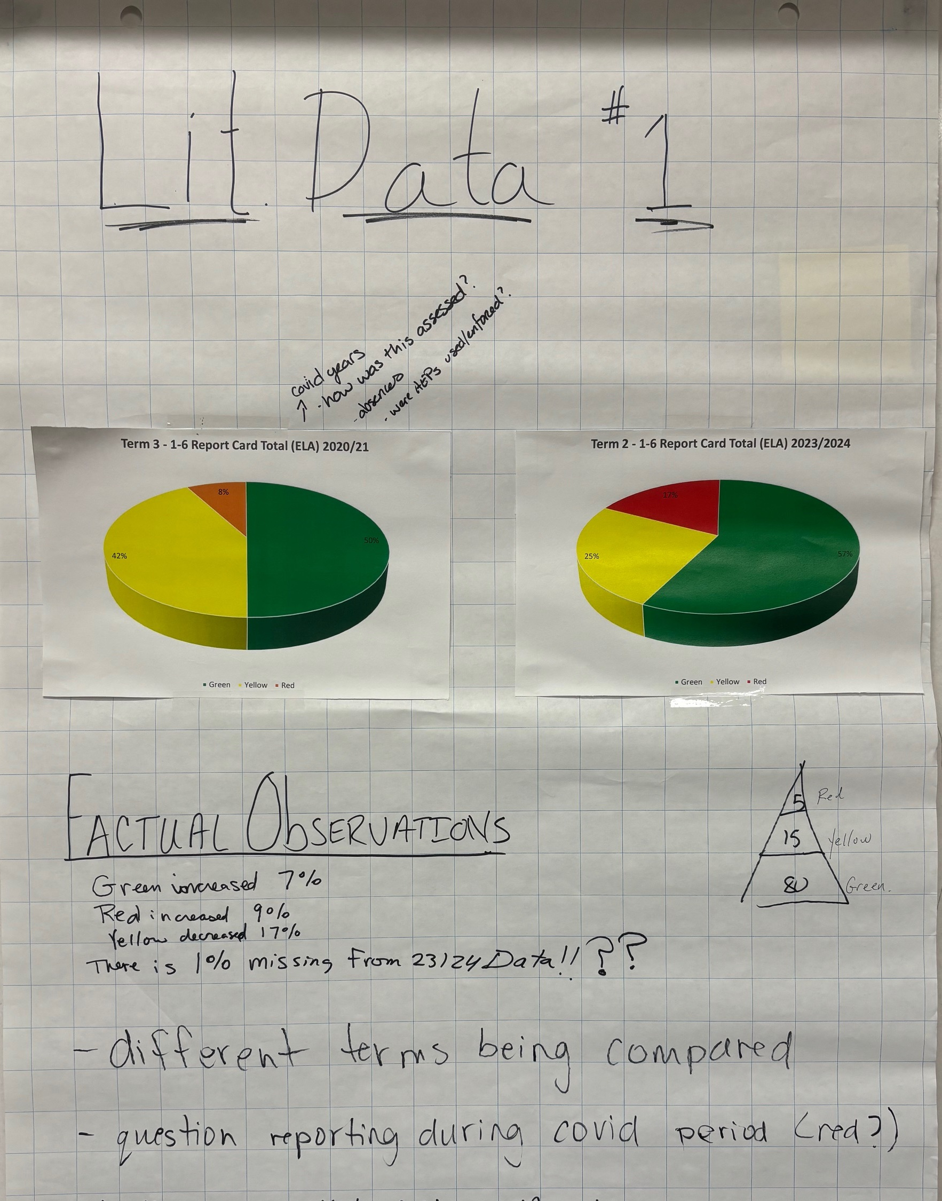
Goal Setting Day
z
Notes:
Today I am going to summarize WMS journey on how we produce our goals and strategies to achieve those goals.
Each May, Whitemouth School dedicates the professional development day to working with data to create two goals. The goals are centered around literacy and numeracy.
On the screen, is an example of a set of data that the staff analyzed this past May. On this chart, staff were given the average of students’ grades across all 5 categories of literacy (reading, listening/viewing, writing, speaking and representing, that teachers report on.
For example, one observation made was student in the Green (3-4) category increased 7% from 2020 – 2023 school years. Red (ND-1) increased by 9% and Yellow (2) decreased by 17%.
From this observation, teachers will then expose their assumptions, based on the factual observations, to produce a one-year plan to address it.

Slide 5
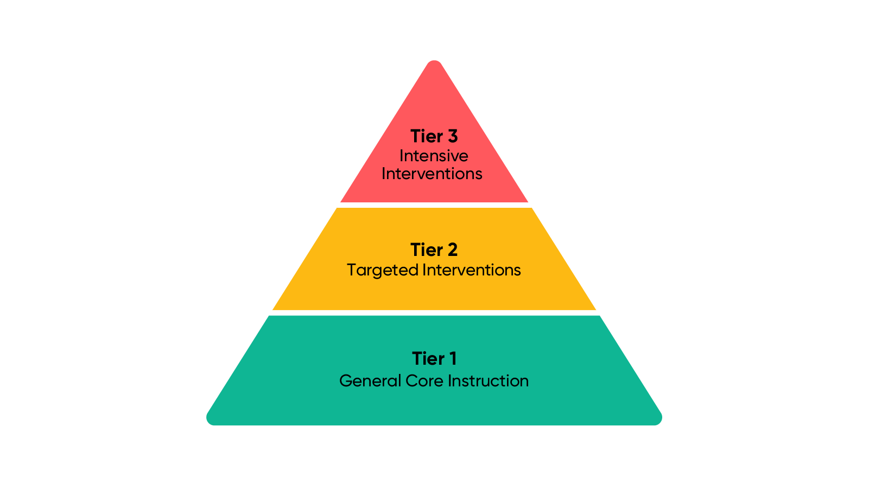
Literacy Goal 2024-2025
Identified factors that lead to success.
Students will demonstrate improvements in reading, writing and comprehension by receiving the required support according to our response to intervention model, which is measured by formative and summative assessments.
Notes:
The first step for the staff is to produce a goal through a collaborative model. This year the literacy team produced the following goal…..
The first part of the goal encompasses the important factors that students need to obtain to have more success in school. The second part, RTI Model, is how students' intervention occurs.
RTI Model Explained →
RTI aims to identify kids who have gaps in their learning.
It uses targeted teaching to help bridge the gap and it encompasses measuring student progress.

Slide 6
Strategies and Resources
Implement (K-2) Literacy Support Program to target ‘emergent - red’ readers (to start) based on formative assessments. (Phonemic)
Implement (3-6) and (7-8) Literacy Support Program to target ‘red and yellow’ students based on formative assessments and collaboration with teachers. (Reading, Writing, Comprehension)
Implement Student Comprehension Assessment 2x per year (1-11).
Utilize divisional reading and writing progressions to help guide teaching.
Notes:
After the goal is created, the team then moved towards how to obtain the goal by creating plans.
The first plan was to utilize the new (K-2) Literacy Support Program to target students who need support in phonemic awareness.
The second plan was to take the former grade 2-6 program and create a 3-8 lit support program. This is due to the refocus of the K-2 program and students who were part of the program in grade 6 moving up to 7.
The SCA formative assessment is being used to continue to support (green) level teaching in the classroom by targeting a metacognitive strategy.
Use the divisional reading and writing progressions for classroom and intervention support.
In the next few slides, I want to give you a more in-depth look at the two programs operating in the early years section at WMS.

Slide 7

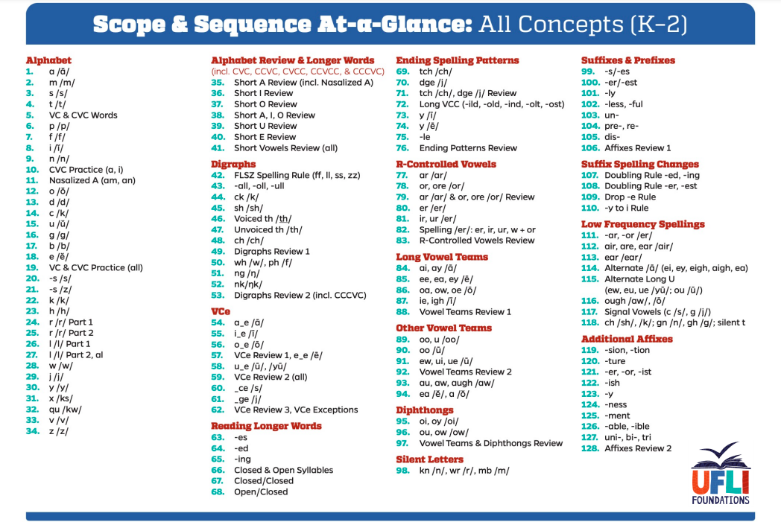
Literacy Support Program (K-2)
Notes:
The Division is allowing schools to explore different programs like UFLI in an effort to ensure students are receiving the foundational literacy skills they require to be successful readers and writers. The UFLI (University of Florida Literacy Institute) program is the main program that is being used in the K-2 literacy support program at Whitemouth School. This is a scripted, routine based program which strongly concentrates on the phonemic awareness. It can be delivered 1 on 1, or small group.
On this slide, the ‘scope and sequence’ gives the sequential order in which students progress is charted and taught. To figure out where students are on this chart to start…

Slide 8
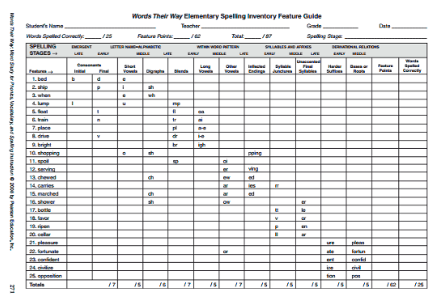
K
Gr.1
Gr.2
Notes:
We use the ‘Words Their Way’ – spelling inventory formative assessment.
The yellow line you see on the left, is where students in Kindergarten should score when they enter grade 1. For example, if a grade 1 student does not do well on their short vowels, we would propose to the parent that their child be involved with the program because they are deemed as ‘emergent’ or in the red for literacy.
A grade 1 student would need to be between the yellow and red line. While a grade 2 student would need to be able to complete beyond the red. All students are tracked for data collection analysis. These lines are based on recommendations by ‘Words their Way” in conjunction with literacy provincial outcomes.
I am now turning it over to Mr. Smith, who is our (K-2) literacy support teacher to share a short, but very important demonstration, on what he may do with a group of students.

Slide 9
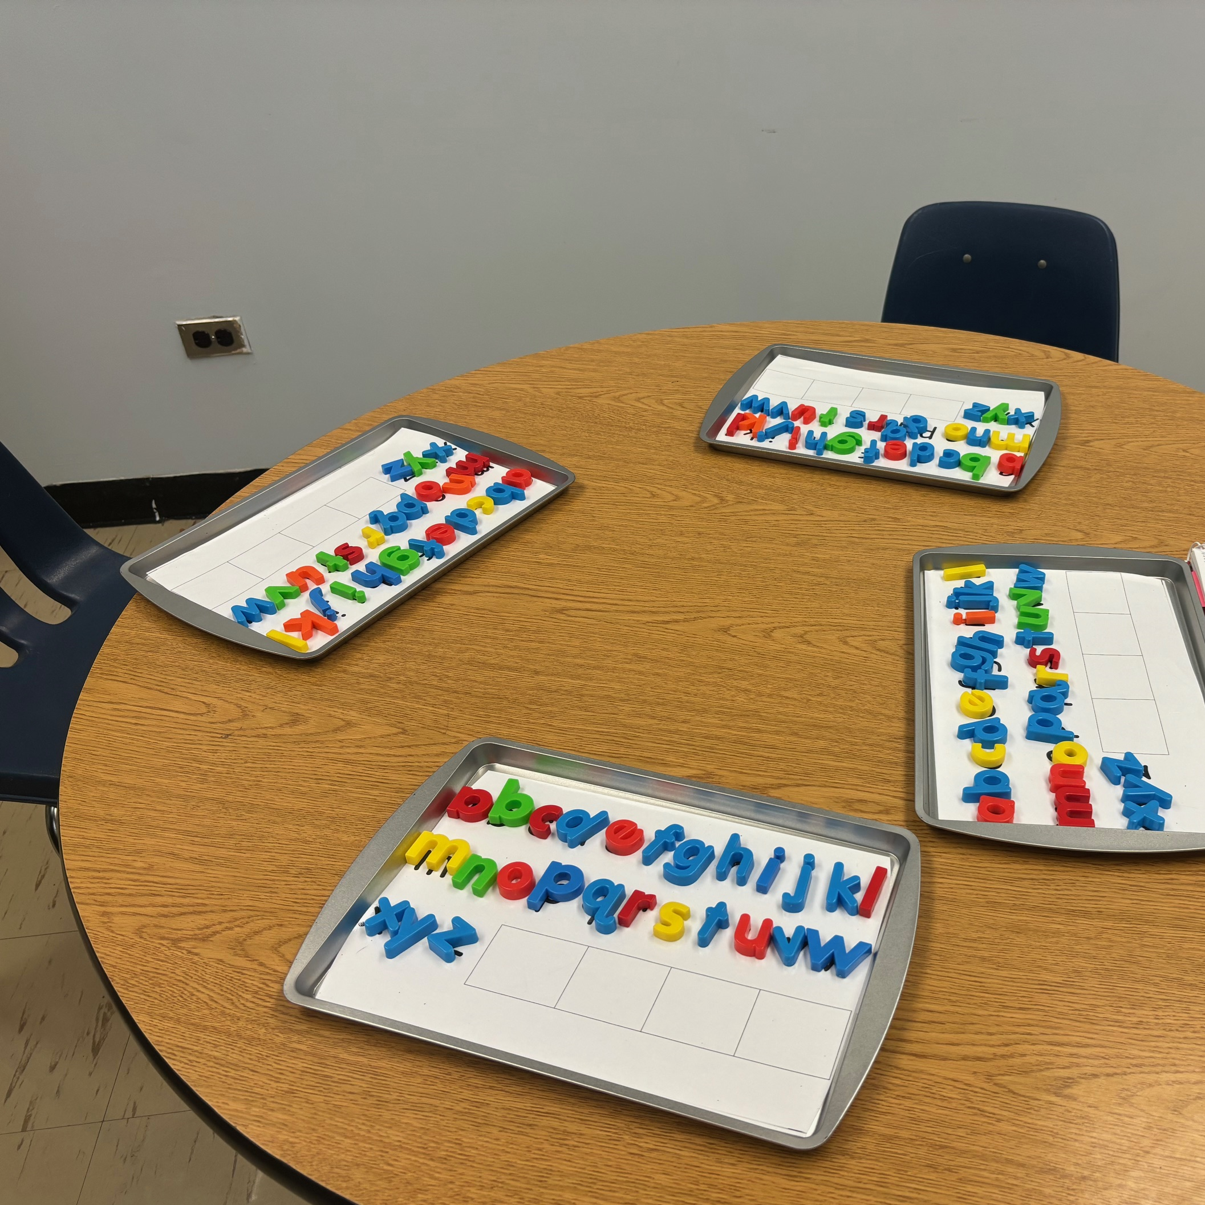
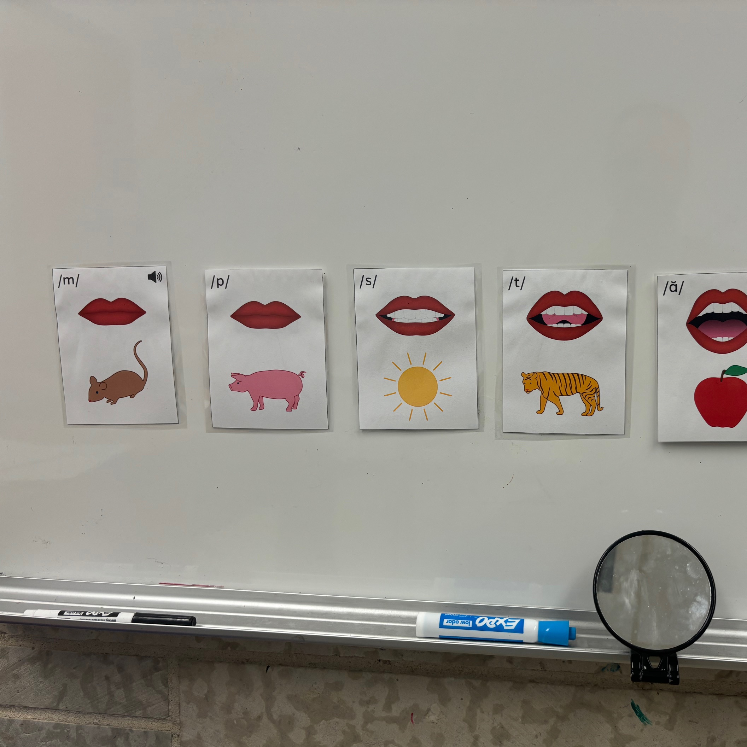
Phonemic Awareness Exercises
Working with Words
Notes:
‘Working with Words
Phonemic Awareness Exercises
Stephen Smith to demonstrate – working with words.

Slide 10
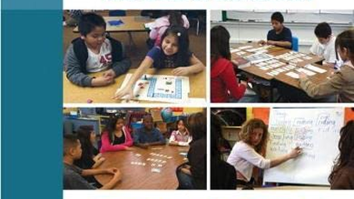
Literacy Support 3-6
z
Notes:
Literacy support for grades 3-6 begins with formative assessments starting the second week of September. Students assessed were previously part of the program last year plus names that are put forward by classroom teachers.
After the assessment, the lit support teacher meets with the classroom teachers to go over students that pertain to them and if there are any others that would need an assessment.
Assessments used to determine support are Words their Way and Literacy Footprints (comprehension – running record).
Students who need the support will bring a support letter home to their parent/guardians asking permission for their child to be part of the program. The intervention lasts 8 weeks and, on that week, a progress report is sent home to the family and classroom teacher. The support teacher will then discuss each student individually with the teacher/parent-guardian to see if targets have been met. If not, they may continue with similar programming, or a different approach might be needed.

Slide 11
Notes:
Last years literacy support covered grades (2-6) and it concentrated mainly on the Fountas and Pinnelle program. There were 22 students involved in the program. Of the 22, 10 students were able to make positive gains after intervention.
This is not exactly where we want to be, however, success was held by all the students in feeling more confident as a reader.
This year, there are 32 students who have been identified as needing literacy support within those 6 categories previously mentioned. The programming has changed due to last years results…

Slide 12
Targeted Intervention (Gr. 3-6)
Decoding/Word Development
Fluency
Comprehension/Understanding
Phonics
Morphology
Types of Writing and Complex Writing
Notes:
This year, the program is a continuation from the K-2 literacy program. Students in grades 3-6 that are struggling with decoding text, will start at the first block. Once the skill is obtained they move onto fluency of reading, comprehension and then into writing based on phonics.
The programs being used during this intervention is…
Do not read….
Reading
Decoding – We believe decoding skills is essential to supporting students in reading complex multisyllabic words.
Fluency – Used to teach students how to ready effortlessly.
Comprehension – Teaching students who struggle with thinking about what they ready and understanding what they read.
Writing
Phonics – Students will learn basic sound-symbol correspondence when writing words.
Morphology – Students who gain the basics of phonics, morphology will be used to writing out move complex words.
Different Types of Writing - Students who needs support during class instruction in a small group setting to write essays, summaries ect.

Slide 13
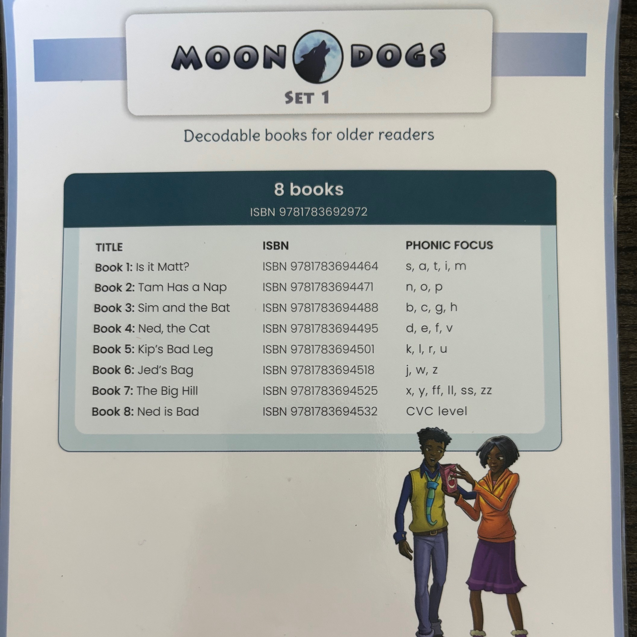
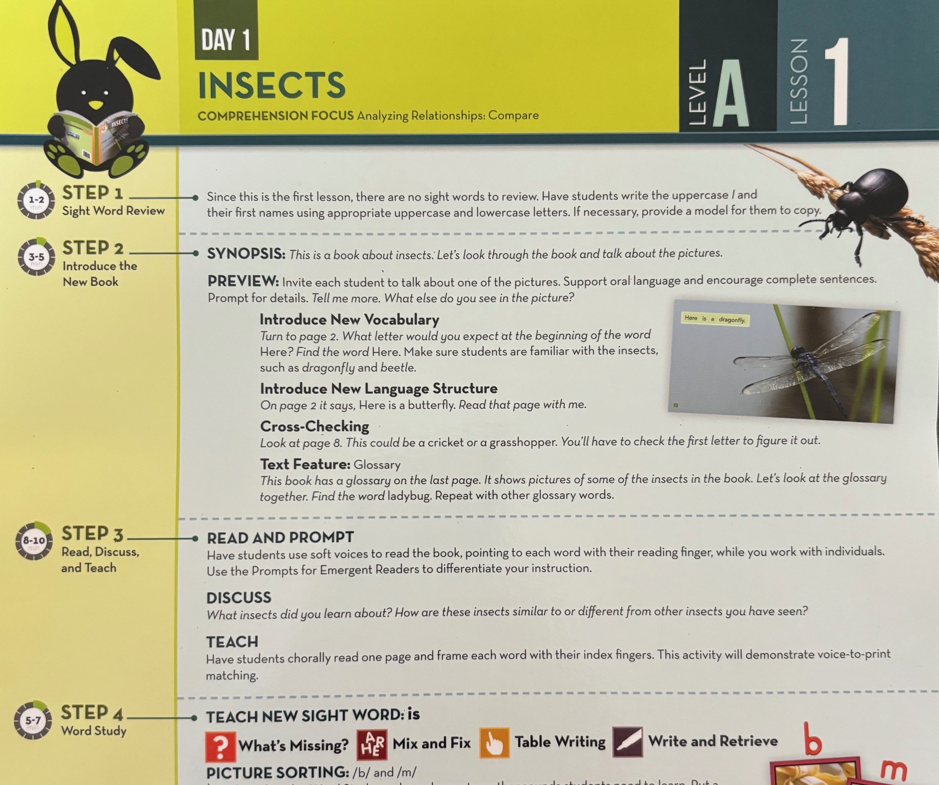
Programs Use (3-6)
Notes:
Decodable books – On the left (primarily used during decoding – fluency – phonics (speech)) are used in continuation from the Ufli program by taking the basics of phonics to decoding the word.
Once the student attains this skill they then move to working on fluency, comprehension and writing with Literacy Footprints.
Middle Years follows a very similar intervention program.
Unique to WMS,

Slide 14
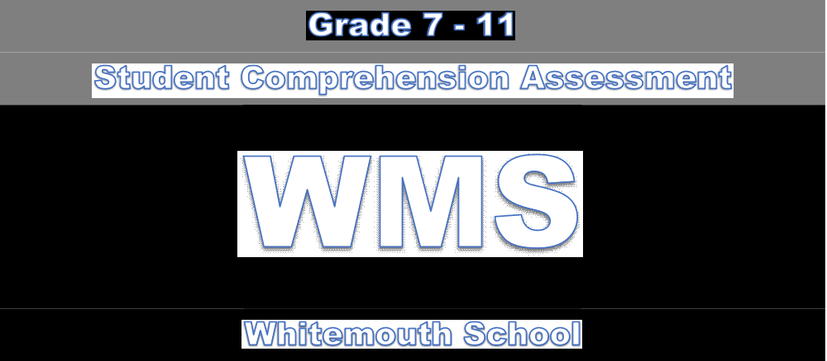
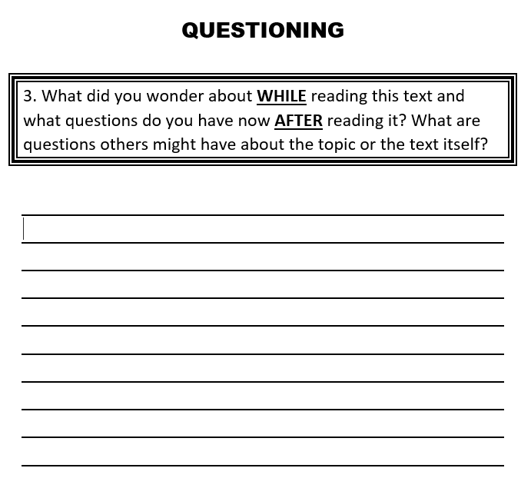
Literacy Support Gr. 1-11
Notes:
Grades 1-11, implement a ‘Student Comprehension Assessment’. The assessment is based on Ellen Keen’s book: Mosaic of Thought. Grades 1-3, 4-6. 7-8, 9-11 all have different rubrics in which students are assessed so that it is grade appropriate.
These assessments are completed two times a year; once in October and once in March/April. Data is given to me and I chart the data for the classroom teacher. We discuss the data and next steps for instruction.
This also supports the numeracy goal of problem solving because students are able to better comprehend what they are reading to complete problem asked.
The next slide gives you an example of the data that is shared with teachers.

Slide 15
Notes:
The left graph is the first SCA assessment for a grade in the fall. After analyzing this data set collectively with the teacher, we agreed that connecting and questioning should be the focus of instruction. This is due to having 8 students scoring between 0-2. After intervention and assessment in the spring, 6 students scored 0-2. The rest of the class was able to be skilled and proficient at making connections with text.
I would now like to share with you an activity that my staff did on the first day which engaged our students into getting to know staff in a bit of a different way.

Slide 16
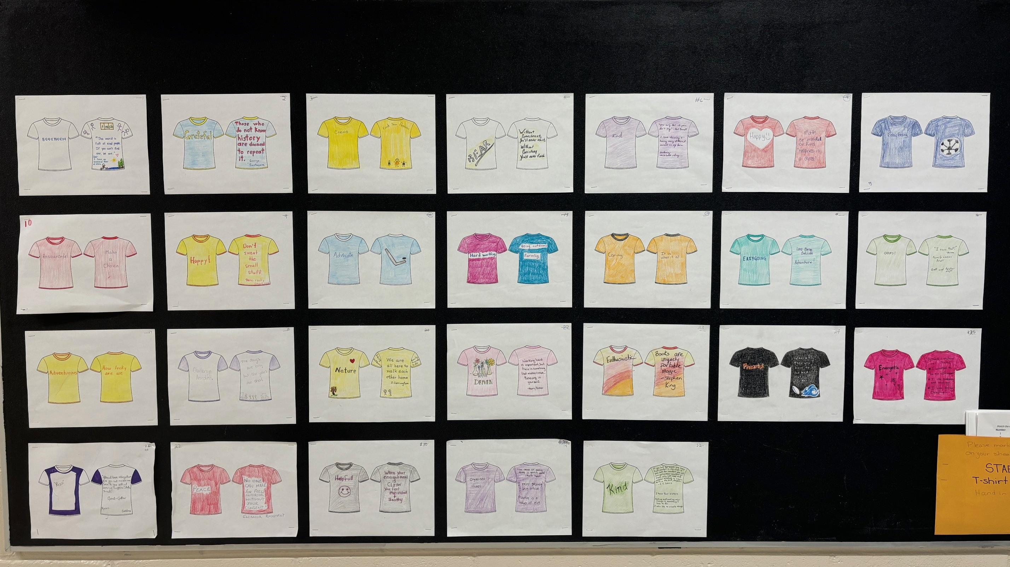
T-Shirt Introductions
z
Notes:
This year, on the first day of school staff created their own t-shirt. On the front they picked one word that described them, and on the back, they put either a favorite quote logo etc.….something of interest they like. They then coloured them. The students were then given a ballot to figure out who’s who from the staff based on their t-shirt.
All the ballots were marked, and the unveiling came at our first assembly of the year.
The idea behind this was for students to get to know staff in a different way instead of looking at staff as their position.
I have given the board a video on USB to view the names to the t-shirts and a picture of our whole school (staff-students) at the end.

