Slide 1

Grade 9 to 12
Credit Attainment

Slide 2
2023-2024 Grade 9
Credit Attainment
Possible Number of In-Class Credits to be Attained:
École Edward Schreyer School = 4
École Powerview School = 4
Lac du Bonnet Senior School = 4
Springfield Collegiate Institute = 4
Whitemouth School = 4

Slide 3
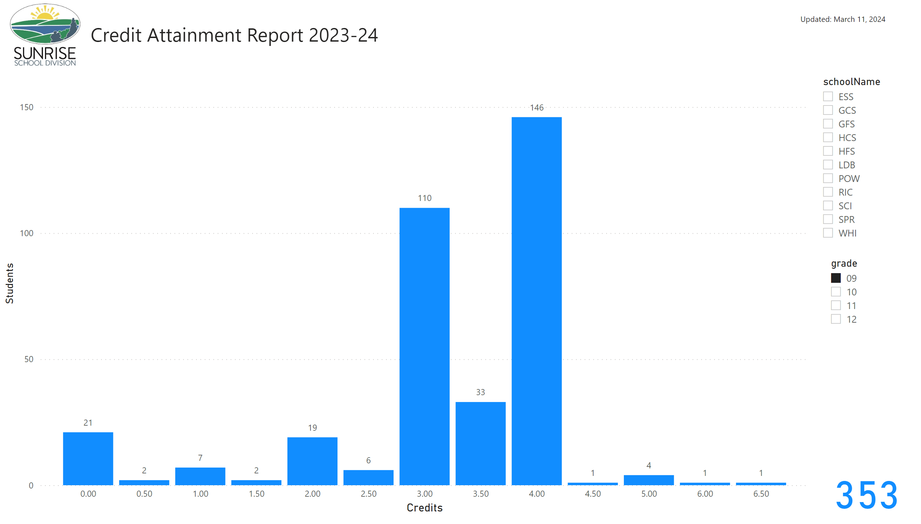
Credit Attainment
Grade 9 - Credit Attainment
Grade 12 - Credit Attainment
Notes:
image
No alt text provided
textbox
No alt text provided
Credits Attained
No alt text provided
slicer
No alt text provided
slicer
No alt text provided
textbox
No alt text provided
card
No alt text provided

Slide 4
2023-2024 Grade 10
Credit Attainment
Possible Number of In-Class Credits to be Attained:
École Edward Schreyer School = 13
École Powerview School = 12
Lac du Bonnet Senior School = 12
Springfield Collegiate Institute = 14
Whitemouth School = 12

Slide 5
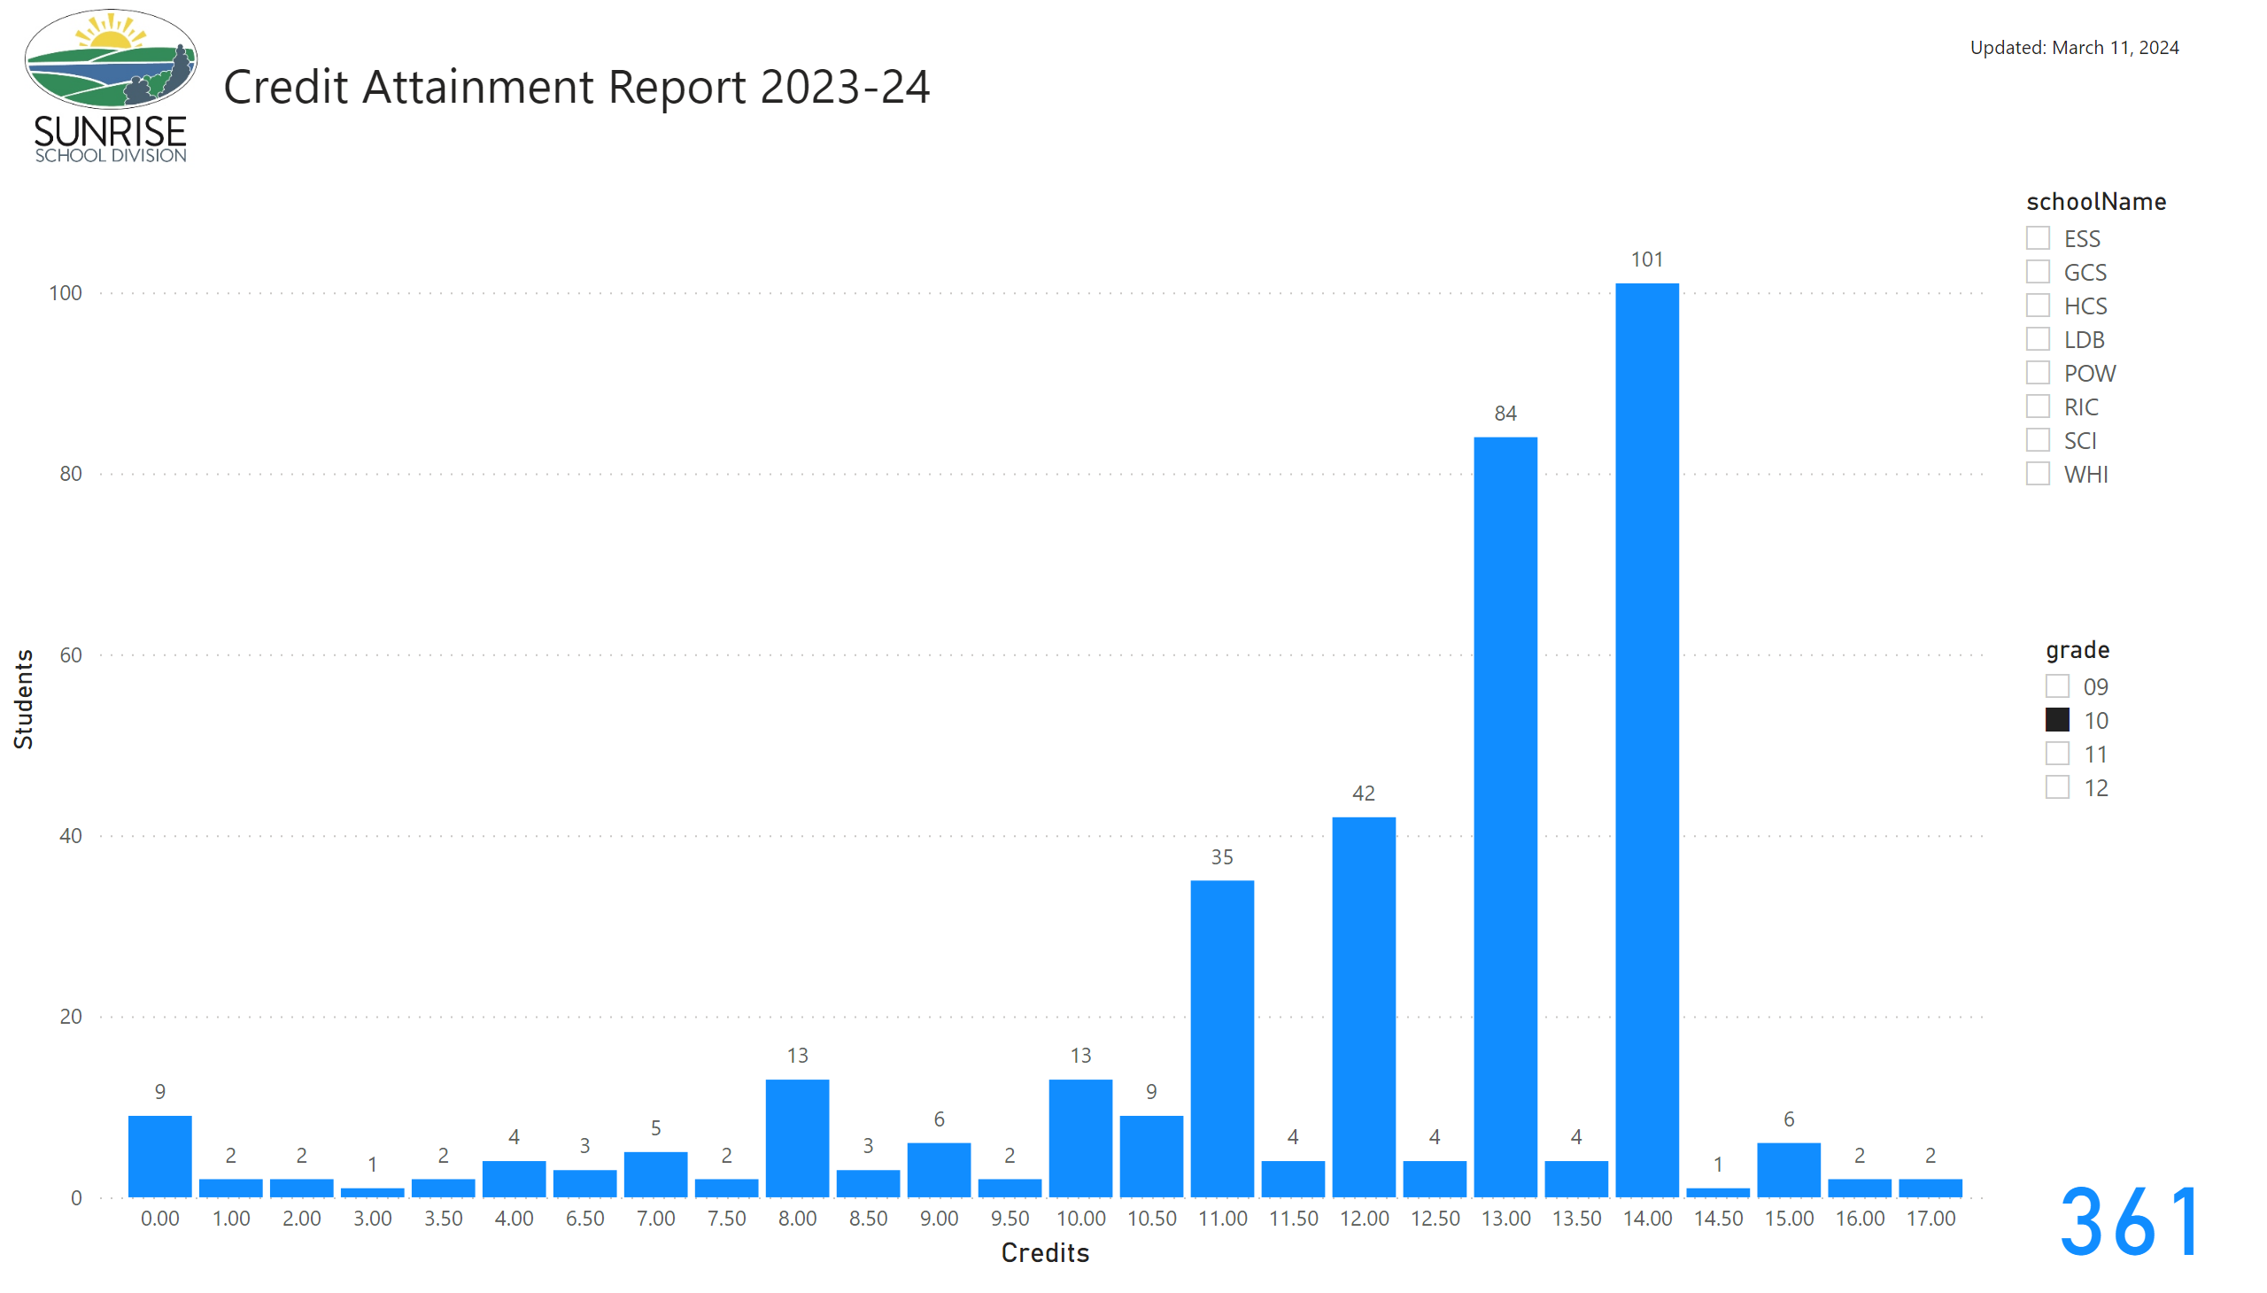
Credit Attainment
Grade 10 - Credit Attainment
Notes:
image
No alt text provided
textbox
No alt text provided
Credits Attained
No alt text provided
slicer
No alt text provided
slicer
No alt text provided
textbox
No alt text provided
card
No alt text provided

Slide 6
2023-2024 Grade 11
Credit Attainment
Possible Number of In-Class Credits to be Attained:
École Edward Schreyer School = 24
École Powerview School = 20
Lac du Bonnet Senior School = 20
Springfield Collegiate Institute = 24
Whitemouth School = 20

Slide 7
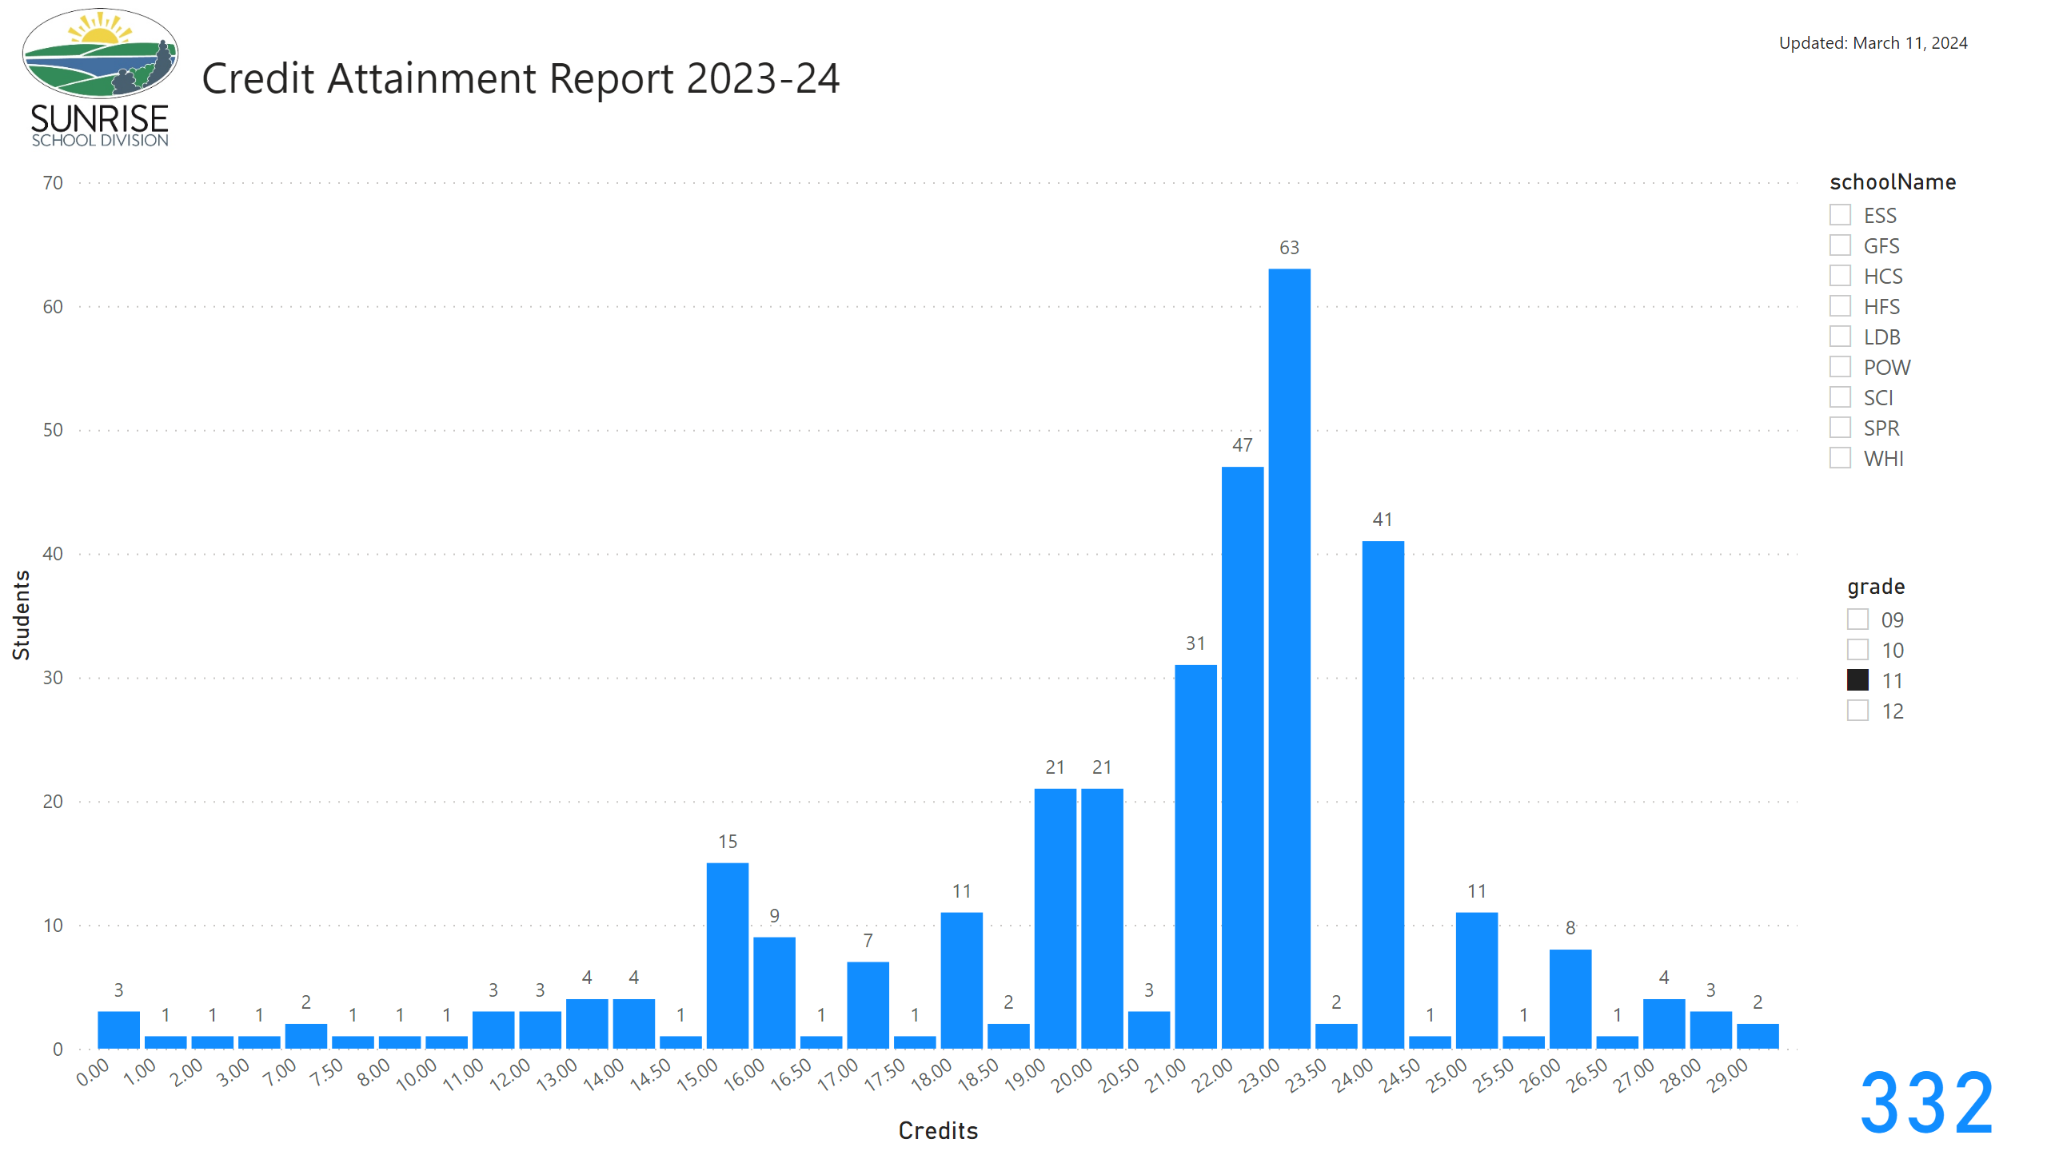
Credit Attainment
Grade 11 - Credit Attainment
Notes:
image
No alt text provided
textbox
No alt text provided
Credits Attained
No alt text provided
slicer
No alt text provided
slicer
No alt text provided
textbox
No alt text provided
card
No alt text provided

Slide 8
2023-2024 Grade 12
Credit Attainment
Possible Number of In-Class Credits to be Attained:
École Edward Schreyer School = 33
École Powerview School = 28
Lac du Bonnet Senior School = 28
Springfield Collegiate Institute = 33
Whitemouth School = 28

Slide 9
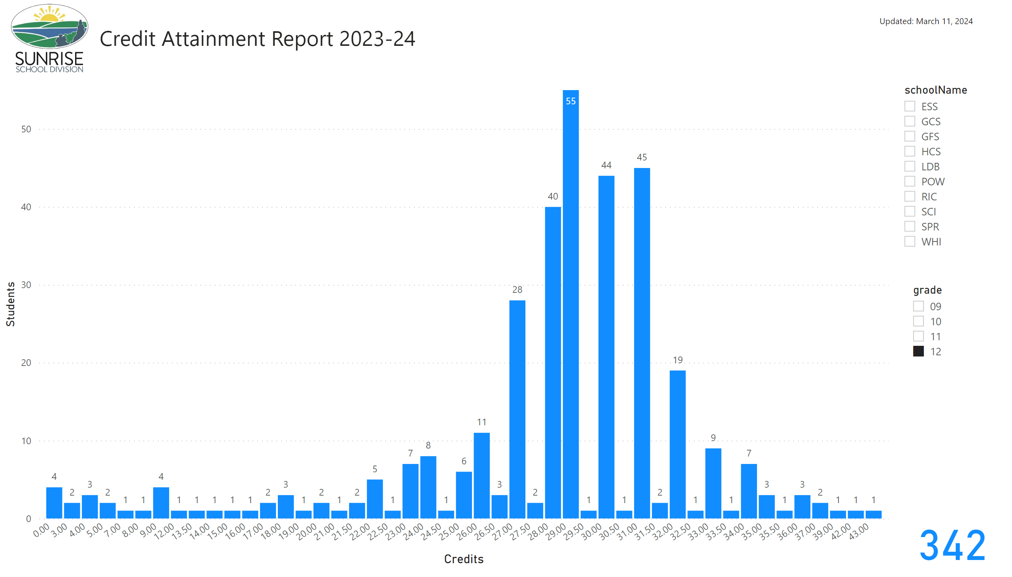
Credit Attainment
Grade 12 - Credit Attainment
Notes:
image
No alt text provided
textbox
No alt text provided
Credits Attained
No alt text provided
slicer
No alt text provided
slicer
No alt text provided
textbox
No alt text provided
card
No alt text provided

